Slide 1
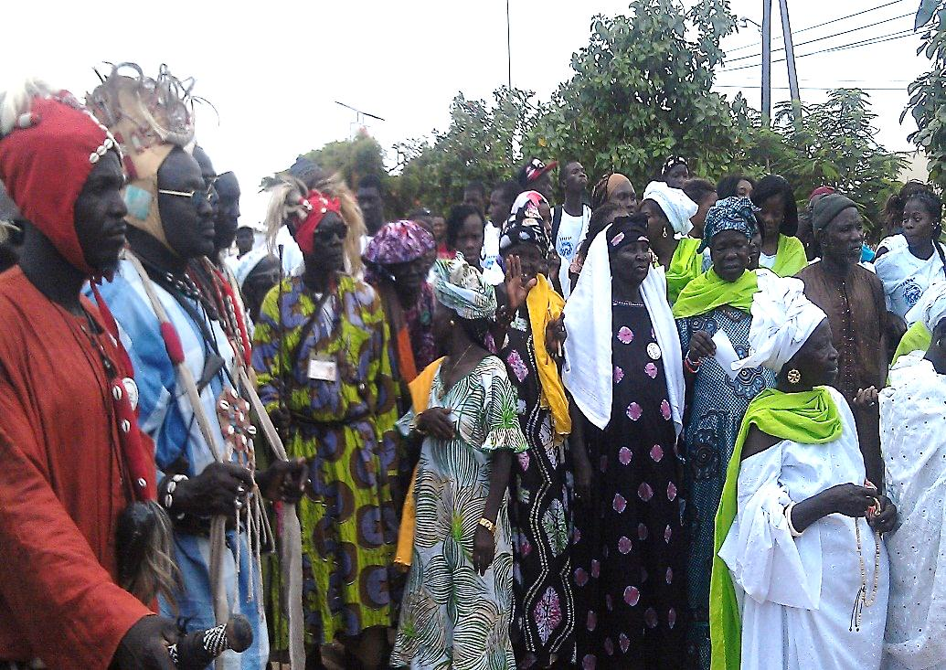
Immunization: Everything we do to keep babies healthy
Good nutrition
Respect for cultural beliefs and practices
Healthy childbirth
Comprehensive health services and infrastructure
Vaccine programs led by traditional healers and community leaders

