Slide 1

Equipping Public Health Leaders Who Can Address the Health Issues in American Indian Communities Through Culturally Congruent Approaches
Donna M. Grandbois, Ph.D, RN
Associate Professor: Dual Appointment in Nursing & Public Health
College of Health Professions
North Dakota State University

Slide 2
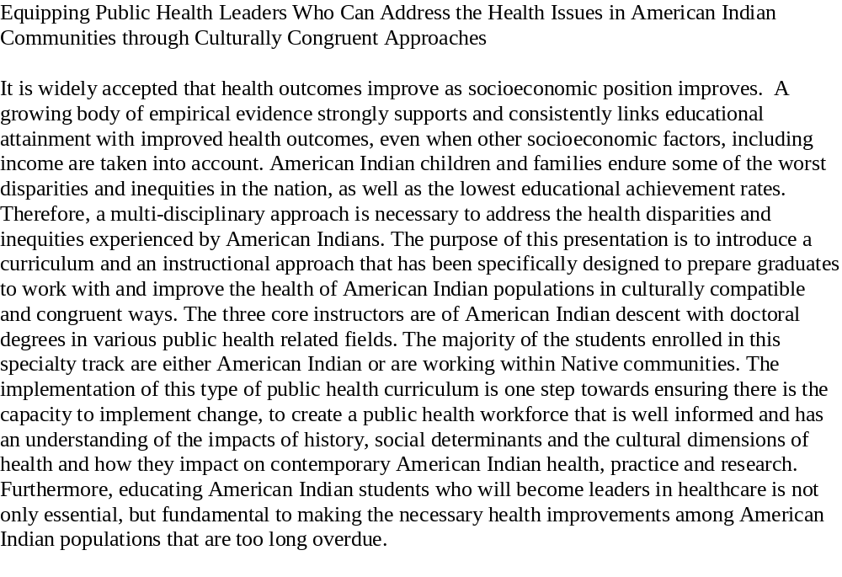
ABSTRACT

Slide 3


Slide 4
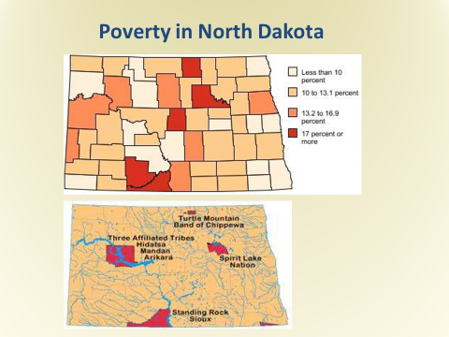
CHALLENGES THAT CONFRONT OUR COMMUNITIES
Cradle to Grave Inequities
Our babies die at a rate almost double the non-native rate
We have high rates of chronic disease with poorer health outcomes
Unemployment is high:14% to 3%
2.5 times as many AI’s lives below the federal poverty level
We have high rates of disability at every age
Lowest high school graduation rates in the nation
Life expectancy is just 54.7 years in some communities

Slide 5
KEY PREMISES
CCC
Point 1
Educational attainment, socioeconomic status,
& better health outcomes are intrinsically linked.
Point 2
Indigenous worldviews & culture are embedded in the curriculum and program
Point 3
Faculty have previous experience working with AI communities & students; all have AI backgrounds
A multi-disciplinary focus is evident in the faculty, curriculum & instructional approach.
Partnering with tribal & urban communities is fully incorporated in public health capstone projects
Point 4
Point 5
These well-educated AI Public Health Professionals can be the change makers needed to address disparities in American Indian communities
Point 6

Slide 6
RESPECTIVE CORE VALUES
Traditional Native Main Stream Society
Cooperative Competitive,Winning
Group/Tribal Emphasis Freedom, Progress, Efficiency
Extended Family/We Individualism, Emphasis on “I”
Patience/Passive “Getting Ahead in Life”
Generous/Non-Materialistic Material Comfort
Respect for Age Youthfulness, Youth Oriented
Spirituality/Universal Connectedness Religion/Denominations
Indirect Criticism Direct Criticism
Harmony with Nature Conquest of Nature

Slide 7
Master of Public Health
Curriculum
Core Curriculum
Fall
MPH 731 Biostatistics
MPH 741 Social & Behavioral Sciences in Public Health
MPH 704 Leading & Managing Public Health Systems
Spring
MPH 751 Essentials in Epidemiology
MPH 710 Health Care Delivery in the U. S.
MPH 720 Environmental Health for Public Health Professionals
Other Specializations: Health Promotion; Public Health in Clinical Systems, & Management of Infectious Diseases
American Indian Specialization
Upon completion of core courses:
MPH 771 American Indian Health Policy
MPH 772 American Indian Health Disparities
MPH 773 Cultural Competence in Indian Health
MPH 774 Research Issues in Tribal Communities
MPH 775 Case Studies in Indian Health
Electives
Required Course work across disciplines
MPH 793 Master’s Paper
MPH 794 Practicum/Internship
More Info

Slide 8
Intrinsic to Our Approach
All instructors are emic to the culture, having an innate understanding of the Indian worldview
The trauma experienced by Native people is acknowledged & incorporated into the work we do with students & their communities
Access to assistance that includes public health services & programming; research; education; & policy are provided
A strong coalition of partnerships is created across the state, at every level of government, & at the community level. We work to have a voice that is heard.
Collaborative research projects occur that empower Indian communities to spearhead & solve their own problems, create their own data banks & set their own agendas

Slide 9
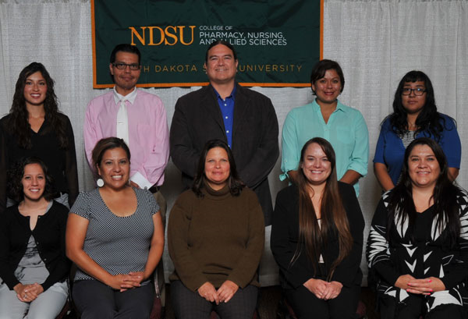
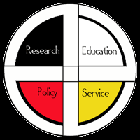
The Academic Program is Partnered with the AI Public Health Resource Center to Consistently Work Along Side Indian Communities
Our vision is engaging & partnering with tribes to improve the delivery of culturally appropriate public health services and functions in American Indian communities. The AIPHRC is enabled by a multifaceted program and team approach to assist each tribe in their service priorities. At the heart of the Center’s philosophy is respect for tribal authority, autonomy, and self determination.
American Indian Public Health Resource Center (AIPHRC)

Slide 10

THANK YOU FOR YOUR TIME & ATTENTION!
“Home of the Bison Nation”

