Slide 1
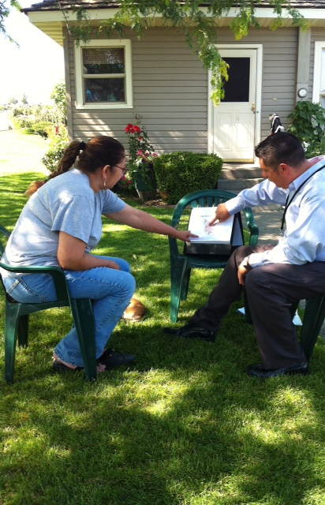


DISCUSSION
This in-home educational intervention is a promising, culturally relevant strategy for addressing behavior change for diabetes among this underserved, vulnerable population. Our findings suggest that promotores play an essential role in the success of the intervention and its ability to influence behavior change at the individual and household-level. Future interventions may achieve greater impact by developing key actionable messages and skills-building activities, and targeting families rather than individuals.
IMPLICATIONS FOR PRACTITIONERS
Promotores are a critical component in encouraging behavior change in this population.
Messages should be concrete, simple, and actionable to help participants achieve small, manageable goals.
Instead of written pamphlets, provide well-designed incentives and tools that build skills in behavior change and empower participants to monitor change.
Encourage participants to involve family members.
“The Promotora Explained Everything.”
Participant experiences during a household-level diabetes education program
Megan Shepherd-Banigan M¹ , Sarah D. Hohl², Catalina Vaughan²,
Genoveva Ibarra^{2,3}, Elizabeth Carosso², and Beti Thompson^{1,2}
BACKGROUND
Rural Hispanics exhibit higher rates of and are at a greater risk for diabetes in the United States. Practitioners must design and evaluate culturally-relevant interventions that focus on diabetes prevention and self-management in this vulnerable population. This study describes participant experiences of a household-level, promotor-led intervention to increase social support, behavioral skills, and self-efficacy and improve diabetes-related behaviors and outcomes.
ACKNOWLEDGEMENTS
A heartfelt thank you to the staff at Centro para Promover la Salud Comunitaria and to the Yakima Valley community who make our work possible. This project was supported by Award Number 5 R24 MD001621 from the National Institutes of Health, National Institute on Minority Health and Health Disparities (NIMHD). The content is solely the responsibility of the authors and does not necessarily represent the official views of the NIH, the NIMHD, or The Fred Hutchinson Cancer Research Center.
METHODS
The Community Advisory Board in the Yakima Valley of Washington State and researchers from the Fred Hutchunson Cancer Research Center (FHCRC) collaborated to design Home Health Parties, in which trained promotores delivered a series of 5 in-home education sessions and distributed incentives to support diabetes-related behavior change.
Home Health Parties were implemented in 430 homes in the Yakima Valley to families of individuals whose A1c test indicated they had diabetes or were at high risk for developing diabetes.
Promotores conducted open-ended, semi-structured interviews with 40 randomly selected Home Health Party participants to determine what associations existed between participant experiences in the intervention and self-reported behavior change.
Qualitative methods were used to determine common themes.
REFERENCES
Centers for Disease Controls and Prevention. National diabetes fact sheet: national estimates and general information on diabetes and prediabetes in the United States. Atlanta, GA; 2011. Available at: http://www.cdc.gov/diabetes/pubs/factsheet11.htm. Accessed May 29, 2012.
Centers for Disease Control and Prevention. National diabetes fact sheet 2007. Available from: http://www.cdc.gov/diabetes/pubs/pdf/ndfs_2007.pdf
Centers for Disease Control and Prevention. National diabetes fact sheet 2011. Available from: http://www.cdc.gov/diabetes/pubs/pdf/ndfs_2011.pdf. Accessed 26 Sept 2012.
Glover S, Moore CG, Samuels ME, Probst JC. Disparities in access to care among rural working-age adults. The Journal of rural health : official journal of the American Rural Health Association and the National Rural Health Care Association. 2004;20(3):193–205. Available at: http://www.ncbi.nlm.nih.gov/pubmed/15298093. Accessed May 29, 2012.
Koopman RJ, Mainous AG, Geesey ME. Rural residence and Hispanic ethnicity: doubly disadvantaged for diabetes? The Journal of rural health : official journal of the American Rural Health Association and the National Rural Health Care Association. 2006;22(1):63–8. Available at: http://www.ncbi.nlm.nih.gov/pubmed/16441338. Accessed May 29, 2012.
¹University of Washington , Department of Health Services, ²Fred Hutchinson Cancer Research Center , Public Health Sciences Division, ³Center for Community Health Promotion

Slide 2
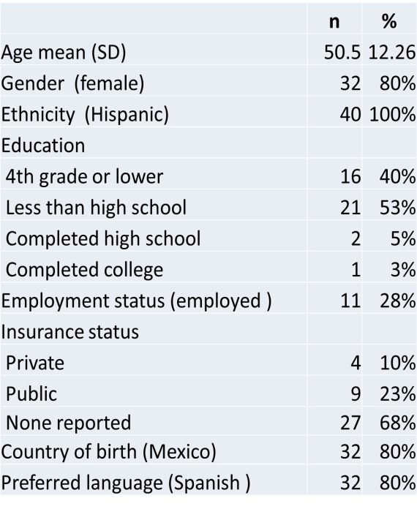
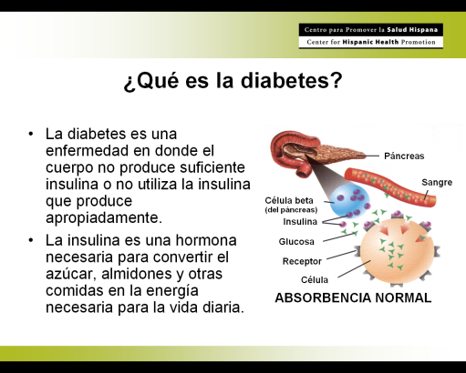
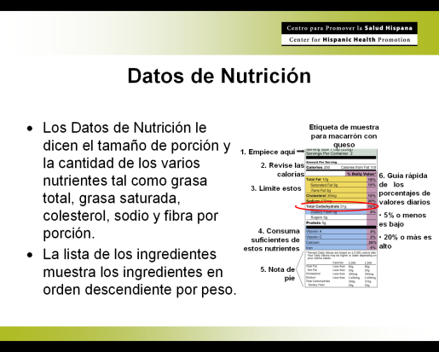

RESULTS and EMERGENT THEMES
Promotores played a critical role in imparting skills, knowledge, and confidence for participants to make behavior changes that impacted their household.
Four primary themes emerged from interviews: (1) participants desire for improving knowledge about diabetes; (2) participant experiences of building skills for diabetes management; (3) the importance of social support and (4) embracing household change.
“Well, the best advice [about diabetes] is given to me by the promotora, because I don’t ask anyone else what to do.”
The promotora told me, ‘A diabetic can live for many years if she takes care of herself like she should.’ And this…I didn’t know. I thought that being diabetic was like having cancer, almost dying, or so I thought.”
.
“The promotora was very professional….I liked this. She gave me assurance. She gave me confidence when she came to visit, taught me the lesson, I felt very calm.”
Flip charts used during the Home Health Party intervention
Incentives, such as pedometers, allowed participants to tangibly gauge their progress and provided instant gratification. Participants reported most behavior changes in their diet and physical activity levels. Several described how they had targeted portion sizes and the quantity of food they consumed in their household. Further, respondents reported reduced HbA1C levels, weight loss, and improved well-being
“Well, ah, [I use] the pedometer, to see how much I am walking.”
“Well, I used to eat more tortilla, more red meat, more soda, I smoked. I don’t smoke anymore, I don’t eat as much red meat, at home we practically don’t eat it, and well, now we eat another kind of meat like fish, vegetables, chicken, things that don’t harm us as much.”
The study was conducted in the Yakima Valley, a rural, agricultural community in central Washington State.
A promotor in the Yakima Valley conducts a Home Health Party.

