Slide 1

Factors Associated with Health Status for Children in Cross-border Appalachian States
Tonimarie Black, B.S.
Julia Farides-Mitchell, M.A.
Robert McGrath, Ph.D.

Slide 2
My Interest
Appalachia Service Project (ASP)
  Works to eradicate substandard housing in the Appalachian region through home repair and restore hope through ministry
  “We accept people right where they are and just the way they are”
  “We believe that affordable, safe, sanitary housing is a basic human right.”
Notes:
Eradicate substandard housing and restore hope through ministry

Slide 3
My Interest Cont.
Worked for many different families in Logan County, West Virginia in the summer of 2012
Returned this past summer as a center director in Knott County, Kentucky
Research project idea was inspired by ASP and the families I have worked for

Slide 4
Introduction
In 2012, the Appalachian Regional Commission commissioned a study to develop the Health Care Costs, Coverage, and Access Index
Disparities in access to adequate health care services has been linked to geographic variables
Children are often the most vulnerable
The study did not look at the health status of children
Notes:
Appalachian Regional Commission
ARC 2012 study - This study found that overall, Appalachian communities realized significantly less access to care, higher levels of insurance, and higher costs of care than other US states or the US average.
West Virginia and Mississippi fared the poorest. West Virginia is almost fully immersed in the Appalachian region where Virginia is only slightly included in this region, yet they share a common boarder.

Slide 5
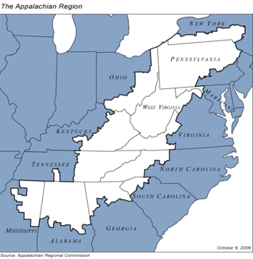
Appalachian Region
Notes:
Ranges from bottom of New York to Mississippi

Slide 6
Quick Facts
Virginia
Population = 8,260,405
Percent below poverty level = 11.1%
Median household income = $63,636
Disability rate = 10.6%
Percent of the population on Medicaid = 13%
Notes:
Percent below poverty level = 11.1%
% population on Medicaid = 13%

Slide 7
Quick Facts Cont.
West Virginia
Population = 1,854,304
Percent below poverty level = 17.6%
Median household income = $40,400
Disability rate = 18.8%
Percent of the population on Medicaid = 22%
Notes:
Percent below poverty level = 17.6%
% population on Medicaid = 22%
Percent below poverty level = 14.5% United States

Slide 8
Literature Review
Research has shown that individuals in Appalachian communities suffer from a higher number of physical and behavioral health conditions, many manageable with routine care
Notes:
Ludke, Philip Appalachian Health and Well-being
Looked in the social determinants of health and pulled out the ones that matched up the best: physical, social, and health care system

Slide 9
Literature Review Cont.
Authors found that health status could be examined using the Evans and Stoddart social determinants of health framework
These domains are: genetic, physical, social, health care system, and individual response
Notes:
Published in 1990

Slide 10
Literature Review Cont.
Age, sex, race, parental education, birth weight, health insurance, as well as Medicare and Medicaid, were associated positively with access to healthcare for children thus improving their health status
The total number of children without full year healthcare insurance coverage is 20.5 million
Notes:
Previous research has stated that health amongst those with less income, causes care to worsen
Education: The more education a parent has, it is more likely the child has better health
Birth weight: It has been found that low birth weights in babies, is positively associated with health status
Insurance: A lack of insurance has been positively associated with health status
Medicaid/Medicare: Medicaid is worse than no coverage at all – The Wall Street Journal- Medicaid is supposed to been required by federal law to deliver dental services, many of their eligible children still lack proper dental care

Slide 11
The Present Study
Hypothesis: Do children in poor primarily Appalachian communities differ in their health status to those in primarily non-Appalachian communities?
National Survey of Children’s Health 2011
  a nationally representative telephone survey that allows for state based estimates
Study examines children and adolescents ages 6-17

Slide 12
Measures and Analysis
Measures
DV: Derived Health Status
Health status was derived using questions recoded into additive scales
  All manageable physical and behavioral conditions were included in the analysis
  For example: Asthma, diabetes, and depression, as well as their severity responses
  Variables used were recoded into categories ranging from 0-3 where 3 indicates worse health or more severe condition
For variables with more than four possible responses, categories were condensed into four broader categories
All analyses were conducted using STATA version 12
Notes:
DV: Derived Health Status
Health status was derived using questions recoded into additive scales
-Have a list on hand of exactly which variables we used. Perhaps make another slide with these in there.
-Remember we coded on scales 0-3, with 3 being the worst
-Example: Asthma Variable – Mild, Moderate, Severe, Unknown
All manageable physical and behavioral conditions were included in the analysis
For example: Asthma, diabetes, and depression, as well as their severity responses
Variables used were recoded into categories ranging from 0-3 where 3 indicates worse health or more severe condition
For variables with more than four possible responses, categories were condensed into four broader categories
All analyses were conducted using STATA version 12
-Example:
-Where condensing was done varied on a) how the item was coded initially b) the type of variable and c) how severity was captured.
----Remember: we had a bunch of self-report questions which we initially considered. we had to build our own categories out of them when we did

Slide 13
Methods and Analysis Cont.
Logistic regressions were run on predictor variables against health status
  Predictor variables were socioeconomic and demographic variables (ex. Income as a % of poverty level, parental education, insurance type etc.)
Backwards elimination was used to finalize the model
Notes:
Logistic regressions were run on predictor variables against health status
-Just in case someone asks you, remember we did weight these with survey weights to minimize skew in the MODELS and normalize results for the ACTUAL POPUATION
-OLS regression used
Predictor variables included socioeconomic and demographic variables (ex. Income as a % of poverty level, parental education, insurance type etc.)
-Have a list of them in your notes in case anyone asks, or you can refer the to the tables coming in a few slides
Backwards elimination was used to finalize the model
-Remember this is when we throw everything into a model and slowly drop those with lowest coefficients/significance in order to reduce model noise (F statistic) and increase the variance accounted for (R squared)
-Also remember what we’re presenting here is the final model; we’re not showing any of the other model steps; people may ask about that

Slide 14
Sample Statistics
1,256 respondents from VA
1,229 respondents from WV
51% were boys
48% were girls
Mean age = 11.7 years
Notes:
Information on my data
1,256 per Virginia
1,229 for WV
Phone survey - majority taken on landline
Gender breakdown by children

Slide 15
Results: Logistic Regressions
West Virginia
Health Status | Coef. | 95% Confidence Interval
No usual place of care | 3.499* | 0.03077 | 6.9689
Kind of place | -0.2871 | -0.8712 | 0.297
Usual Provider of care | 2.276*** | 1.1732 | 3.3794
Not covered | -0.1125 | -2.1036 | 1.8786
Delayed or not received care | 0.845 | -1.6868 | 3.3769
No physical exam | 2.4601* | 0.2691 | 4.6511
Lack of dental care | 0.92 | -0.6327 | 2.4728
No vision care | -0.0963 | -1.144 | 0.9513
Age | 0.06154 | -0.1371 | 0.2602
Race | 1.5837 | -0.2772 | 3.444
No personal doctor | -0.0362* | -0.0723 | -0.0001
Premature | 0.1255 | -1.7316 | 1.9827
Sex | -1.756* | -3.1399 | -0.372
Parental education | -0.0606 | -0.6613 | 0.5399
Poverty level | -0.6351*** | -0.9158 | -0.3543
Insurance type | -0.0379 | -0.1032 | 0.02733
***p<.001 **p<.01 *p<.05
# of obs | 1075
Notes:
West Virginia
Poverty level and usual provider of care are significant at the .001 level
No usual place of care, no physical exams, no personal doctor, also sex are all significant at the .05 level

Slide 16
Results: Logistic Regressions Cont.
Virginia
Health Status | Coef. | 95% Confidence Interval
No usual place of care | 6.5277 | -2.092 | 15.1479
Kind of place | -0.0874 | -0.8125 | 0.6377
Usual Provider of care | 0.5014 | -0.5649 | 1.5677
Not covered | -0.664 | -2.1056 | 0.7775
Delayed or not received care | 6.3243** | 1.5895 | 11.0591
No physical exam | 2.6052*** | 1.6914 | 3.519
Lack of dental care | 1.0181 | -1.1788 | 3.215
No vision care | 0.2214 | -0.685 | 1.1279
Age | -0.005 | -0.2321 | 0.2219
Race | 0.194 | -0.6871 | 1.0751
No personal doctor | -0.0001 | -0.0461 | 0.0457
Premature | 2.0453 | -1.6678 | 5.7585
Sex | -1.617* | -2.9826 | -0.2519
Parental education | -0.3751 | -1.2521 | 0.5018
Poverty level | -0.2854 | -0.6296 | 0.0588
Insurance type | -0.0508*** | -0.0793 | -0.0222
***p<.001 **p<.01 *p<.05
# of obs | 1079
Notes:
Virginia
Sex is significant at the .001 level
Delayed or not received care is significant at the .01 level
No physical exam as well as insurance type are all significant at the .05 level

Slide 17
Findings
Children in West Virginia have a higher health burden than children in Virginia
Children in West Virginia are not receiving the needed care from a usual provider of care
Children in West Virginia have a worse health status when their poverty level is high
Notes:
“The Mobile Medical Unit” goes out to different homeless shelters as well low income neighborhoods and offers free health services.
Doctors Without Borders, primarily works in developing countries or in countries with epidemic.

Slide 18
Findings Cont.
Children in Virginia who do not receive physical exams have worse health status
Children in Virginia who have public insurance have worse health than children with no insurance coverage at all

Slide 19
Policy Implications
Expansion of Medicaid through the Affordable Care Act
  “cover the gap” between current Medicaid eligibility and families being able to afford private health insurance using marketplace subsides
  West Virginia is expanding Medicaid coverage, whereas Virginia is not expanding Medicaid coverage
Notes:
Provides them with a usual place of care
“provider centric medical home” – someone takes care of you
In
West Virginia, almost 166,000 uninsured parents and other adults would become eligible for Medicaid in 2014
Mention income and insurance as well as usual place of care

Slide 20
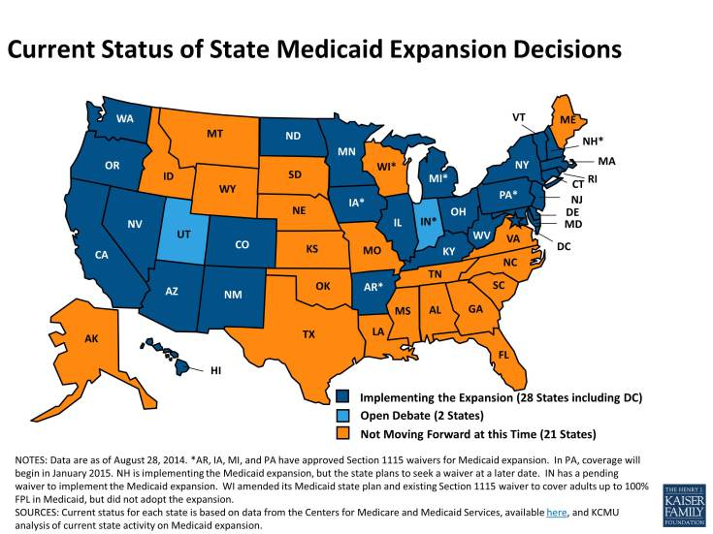

Slide 21
Limitations
Comparison group is not completely outside of Appalachia
Who answered the survey?
Appalachian region and access to healthcare has limited research to reference

Slide 22
Thank You!

