Slide 1
Engaging Entry Level Undergraduate Nursing Students in Population Health
Kim Alexander Decker, PhD, RN, CNS
Chad Priest, JD, MSN, RN
Desiree Hensel, PhD, RN, PCNS-BC, CNE
Joyce Splann Krothe, PhD, RN

Slide 2
Promoting Healthy Populations
Course is part of a major BSN curriculum revision
Introductory level course in first semester
Intent was to introduce community based concepts at the very beginning of the nursing curriculum
Notes:
New course taught for the first time fall 2013…named Promoting Healthy Populations, 5 cr course (3/2)
Previous curriculum focused almost entirely on the acute care setting….community not addressed until the last semester in senior year
Intent was to introduce these concepts earlier

Slide 3
Expected Course Competencies
Employ introductory community assessment concepts to an identified geographic area and/or population.
2) Apply growth and development concepts in
the care of individuals and families.

Slide 4
Expected Course Competencies
3) Integrate data, class concepts, and partner site needs to provide a service project for the partnering site or agency.
4) Conduct a focused assessment of an individual or family with regard to selected health behaviors in order to create an individualized health promotion plan.

Slide 5
Course Overview
Social Determinants of Health Overview
Poverty Simulation
Windshield Survey
Culture of Care
Goal University
Notes:
Talk about Goal U. and Culture of Care

Slide 6
Unnatural Causes
Introduction to Social Determinants of Health
Lack of health care does not cause disease
Geographic patterns of disease
International rankings for leading health indices
We can no longer afford to keep treating people’s illnesses without fixing what it is that makes them sick
Notes:
Social Class determines health------upper SES lives in a duplex with a lower SES, the lower SES will have better health
Dominant Monkey-creates optimal environment (same with people) has control, decreased stress than subordinate
Subordinate Monkey- no control, chronic stress, increased cortisol, increased heart rate, increased plaque in arteries
Increased education and income- decreased cortisol release during the day
Students looked at home county for rankings

Slide 7
Poverty Simulation
Utilized vendors who actually work in the roles -13 from the community
Students lived in Poverty 4 weeks in 15 minutes segments
Family must navigate welfare system while procuring food, shelter, child care and healthcare

Slide 8
Poverty Simulation
Pre-and posttests showed students:
Recognized more societal structural perspectives to poverty;
Less stigma toward the welfare system following the poverty simulation;
Increased negative perceptions of personal character deficiencies of persons living in poverty.
Notes:
Examples from the poverty tool by Yun and Weaver:
People are poor due to circumstances beyond their control, poor people are discriminated against, & we have a responsibility to help them
Welfare mothers have babies to get more money, a lot of fraud in the welfare system, some poor people live better than I do considering all their benefits
Poor people are different from the rest of society, poor people are dirty and dishonest, poor people act differently, have lower intelligence and different set of values
Paper submitted for review

Slide 9
Poverty Simulation Conclusions
Poverty Simulations the first step
Face-to-face interactions with impoverished community members was needed to help change attitudes. Service Learning experts suggest 20 hours to change attitudes (following junior community health course will work at the Shalom Center-a local daytime homeless resource center)
Notes:
Proctor, P., Lake D., Jewell, L. et al. Influencing student beliefs about poverty and health through interprofessional community-based educational experiences. Journal of Research Interprofessional Practice Education 2010, 1(2) 145-58.

Slide 10
Culture of Care
Developed due to a nationwide health & safety concern on college campuses
Campus wide effort-health - 40,000 students
Poor outcomes happening which could have been prevented if onlookers had just acted
Notes:
The IUSON seeks to positively influence the health of communities served in part by shaping care through partnerships. With over 40,000 students, the Indiana University Bloomington Campus is one such community with health and safety needs that are unique to a large, residential university. The Culture of Care project is a campus wide effort that grew out of a growing nation-wide concern that bad outcomes were happening to students which could be prevented if onlookers had just acted. Based on the concept of bystander intervention, the goal of the project is to teach simple techniques that empower students to take action when they see a situation that is potentially dangerous, even if it is just to call for help. The four specific areas Culture of Care addresses are sexual well-being, mental health, alcohol & drug awareness, and respect. These focus areas tightly align with the Healthy People 2020 objectives and the School of Nursing’s core values of respect and responsibility making this project of importance to nursing.

Slide 11
Culture of Care
Four Specific Areas Addressed:
Sexual Well-Being
Mental Health
Alcohol & Drug Awareness
Respect

Slide 12
Culture of Care
Initial 4 hour training for all students
Bystander intervention in different situations
Learned words to use if a friend:
  Was drinking too much
  Acting in a way might regret the next day
  Seemed seriously depressed
Notes:
Courage is Non Conformity and Silence is Acceptance = TAKE A STAND!
Need confidence: communication skills
Assertive: think of actions
Make a Plan: talk to someone else, safety in numbers, get help
Affective words can use:
I care
I noticed (that you aren’t going to class)
I feel (uncomfortable when)
I want
If see hazing= call the Dean of Students Ethics Office

Slide 13
Culture of Care
Actual clinical hours:
  Sober Monitor
  Planning an alternative to drinking activities
  Leading small or large group discussions
  Taking friends to related campus lectures
  Participated in Awareness Runs
  Joined groups that related to Culture of Care

Slide 14
Culture of Care Results
Felt empowered to intervene and support their peers to reduce health risks
Realized 1 person can indeed make a difference in another person’s life
Gained professional skills - educators, leaders and advocates
Notes:
Wrote reflection papers
“How many people were impacted?”
“How did it make you grow?”

Slide 15

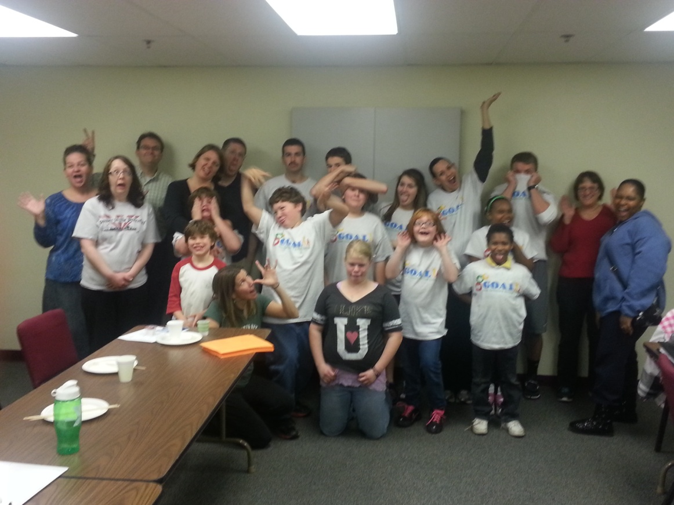
What is ?
The mission of the G.O.A.L. program is to provide kids and families the opportunity to receive education and support on nutrition, fitness, and behavioral habits in order to make positive life-long changes for an active lifestyle.

Slide 16
Goal University
Stands for Get on Board for Active Living
Students went twice a week to after school programs in groups of 6
Themes of the week
Pre and post eating survey of elementary aged students for data collection

Slide 17
Goal University 6 Lessons
Week 1 – My plate, whole grains and the benefit of exercise
Week 2 – Fruits, vegetables and sedentary exercise
Week 3 – Healthy Drinks and Pedometers
Week 4 – Dairy and Group Exercise
Week 5 – Protein and Muscles
Week 6 – Review and Celebration

Slide 18
Conclusion
Excellent student evaluations
Further course revisions, ongoing process
Looking at how introducing healthy populations early on affects their perceptions of the nursing role
Notes:
Scheduled workshop in the summer with a health coaching expert
If view role as helping sick people vs family and community

