Slide 1
Application of Spatial Statistics, Segmentation and Market Solutions to Examine Disparities in Heart Disease and selected Risk Factors in The District of Columbia
Oral Presentation at The 143rd APHA Annual Meeting and Exposition(October 31 – November 4, 2015), Chicago

Slide 2
George Siaway, PhD, Christine A. Clarke, MS, Fern Johnson-Clarke, PhD and Rowena Samala, MS
District of Columbia Government Department of Health
Washington, DC 20001
Session 4041.0, GIS Mapping, Public Health Policy and Prevention Strategies, Tuesday, November 3, 2015 at 8:30 AM

Slide 3
ABSTRACT
Introduction:
Despite the fact that deaths due to heart disease have declined over the years, heart disease remains the number one killer of Americans, and cost the nation an estimated $108.9 billion in 2010. Within the District, heart disease is the number one leading cause of death and the second leading cause of hospital admissions. In 2012, 1,250 deaths were caused by heart disease and accounted for nearly 27.7 percent of all District resident deaths. There is a dearth of data on the burden of heart disease in the District.
Objectives:
This study seeks to evaluate the public health burden of heart disease mortality, incidence, hospital discharges, and selected modifiable risk factors (diabetes, obesity, smoking, and access to healthy foods) and non-modifiable risk factors (age and access to quality health care) by analyzing their spatial patterns, and identifying high-risk zip codes. Public health burden for this study refers to collocation of high heart disease mortality, incidence, hospital discharges, diabetes, overweight and obesity.
Method:
Data sets from the Center for Policy Planning and Evaluation-Vital Records on heart disease mortality and incidence for year 2012, the State Health Planning and Development Agency (SHPDA) hospital discharges, Directors of Health Promotion and Education (DHPE) Neilson Dominant Lifestage Group, and the Community Health Administration (CHA) Health Professional Shortage Area (HPSA) and Medically Underserved Area/ (MUA/P) were geocoded and analyzed using ArcGIS 10.2 and its spatial statistics toolbox. Hot Spot Analysis was used to identify statistically significant hot and cold spots for heart disease incidence, mortality, hospital discharges, lifestage groups and selected risk factors.
Results:
The burden of heart disease is disproportionately distributed across District zip codes. The study demonstrated disparities in heart disease incidence, mortality, and hospital discharges in all Ward zip codes. The greatest public health burden of heart disease was in parts of Wards 2, 5, 6, 7, and 8 zip codes.
Conclusions:
Generally, high heart disease incidence, mortality, and hospital discharges were collocated with high diabetes, overweight, obesity, smoking and the 65-plus age group. Heart disease mortality was greater among vulnerable populations such as older adults (55-plus age group), racial/ethnic minorities (Blacks/non-Hispanics), and people with lower income.

Slide 4
BACKGROUND: HEART DISEASE-IMPORTANT PUBLIC HEALTH PROBLEM
Heart Disease-leading cause of death in the District¹.
About 16.1 percent decrease in age-adjusted death rate between 2007 and 2011².
Age-adjusted death rates for heart disease increased from 191 deaths to 208.9 deaths per 100,000 population (preliminary 2012 data) in 2012.³
Major contributors to disparities in heart disease burden include socioeconomic, demographic (age, gender, race/ethnicity) and geographic variables.
Healthy People 2020 (HP 2020) objective is to reduce heart disease deaths to 100.8 deaths per 100,000 population⁴.
1. Data Management and Analysis Division, Center for Policy Planning and Evaluation, DC Department of Health
2. Data Management and Analysis Division, Center for Policy Planning and Evaluation, DC Department of Health
3. Data Management and Analysis Division, Center for Policy Planning and Evaluation, DC Department of Health
4. Healthy people 2020 Topic Area and Objectives
http://www.healthypeople.gov/2020/topicsobjectives2020/pdfs/HP2020objectives.pdf

Slide 5
PROBLEM OVERVIEW AND METHODS
District’s LEADING CAUSES OF DEATH
Figure 1 shows the ten leading causes of death in the District.
Heart disease and cancer are two leading causes of deaths in 2012 at 27 and 23 percent respectively.
Accident and cerebrovascular disease deaths occur at 4 percent.
METHODS
ArcGIS 10.2: Cluster Analysis (Hotspots) – statistically significant hot and cold spots
Spatial Autocorrelation Analysis – measures the level of interdependence between variables and the nature and
strength of the interdependence.
Directional Trend Analysis - determining where to best locate and spend limited resources to improve intervention.
Bayesian Kriging - geostatistical interpolation method that allows accurate predictions of moderately nonstationary
data.
Anticipates future trends with levels of uncertainty.

Slide 6
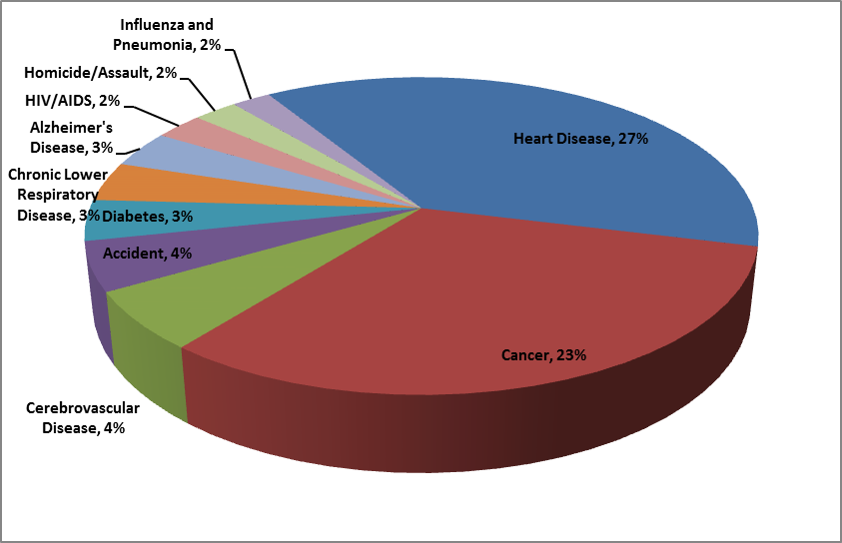
FIGURE 1: LEADING CAUSES OF DEATH, 2012
Data Management and Analysis Division, CPPE

Slide 7
FIGURES 1 – 2: HEART DISEASE HOSPITAL DISCHARGES
Figure 1 shows spatial distribution patterns of high heart disease hospital discharges .
Figure 2 shows hot spots of high heart disease hospital discharges .
Disparities in spatial patterns of heart disease and heart disease hospital discharges.
Hot and cold spots of heart disease hospital discharge rates: consistent with spatial patterns of heart disease hospital discharges.
Spatial patterns are statistically significant.
Variations in spatial patterns of heart disease hospital discharges are not due to chance.

Slide 8
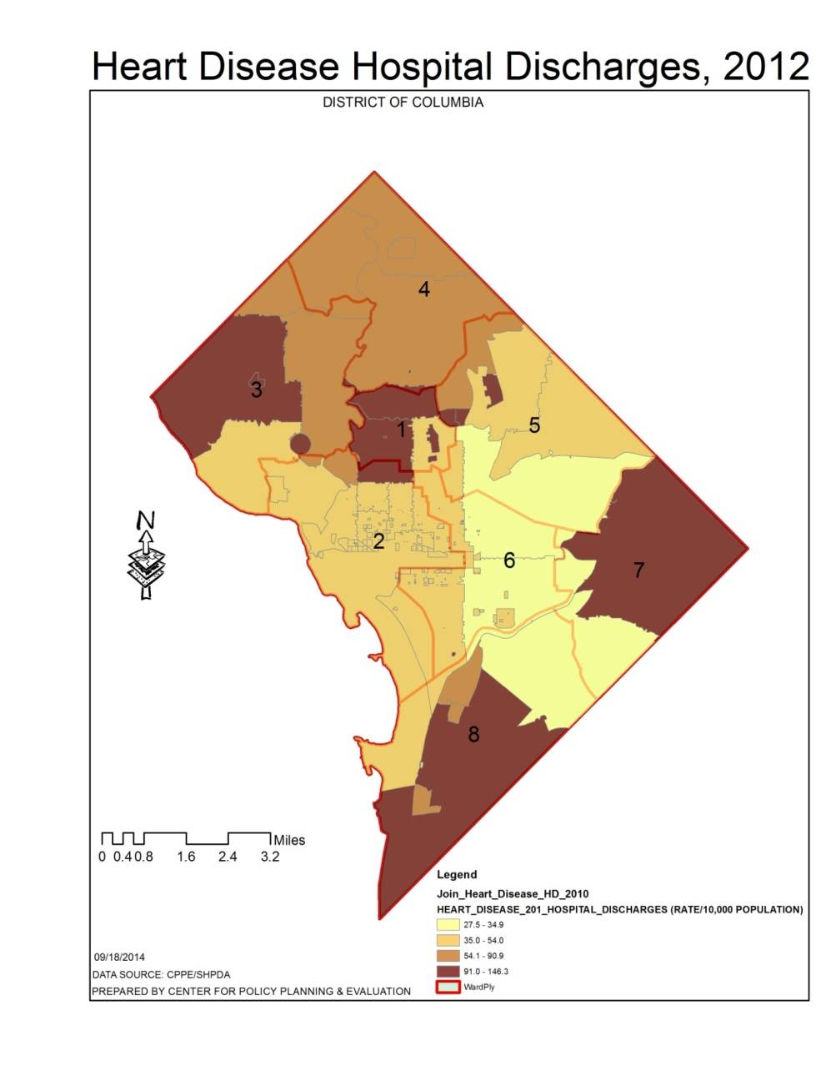
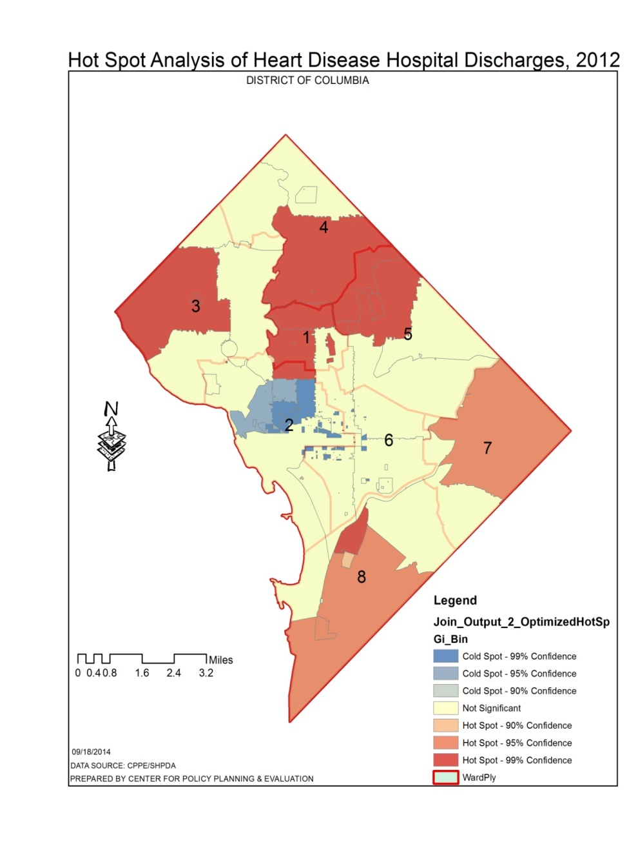
FIGURES 1 – 2: HEART DISEASE HOSPITAL DISCHARGES, 2012
Figure 1: Spatial Distribution of Heart Disease Hospital Discharges, 2012
Figure 2: Hot Spot Analysis of Heart Disease Hospital Discharge, 2012

Slide 9
FIGURES 3 – 4: SPATIAL TRENDS OF HEART DISEASE HOSPITAL DISCHARGES, 2012
Figure 3 shows Heart Disease Hospital Discharges – high in Wards 1, 2, 3, 5, 7 and 8 zip codes (Brown Polygons).
Figure 4 is a trend analysis of Heart Disease Hospital Discharges.
Heart Disease Hospital Discharges start high in the north (Wards 1, 3, and 5), gradually decrease towards the middle (Ward 6) and increase southward in Ward 8 (Blue Arc).
Heart Disease Hospital Discharges also start high in the east (Ward 7) , gradually decrease in the middle (Wards 2 and 6) and gradually increase westward through Wards 6 and 2 (Green Arc).
Directional trend analysis can aid in focusing cost-effective intervention strategies for Heart Disease.

Slide 10
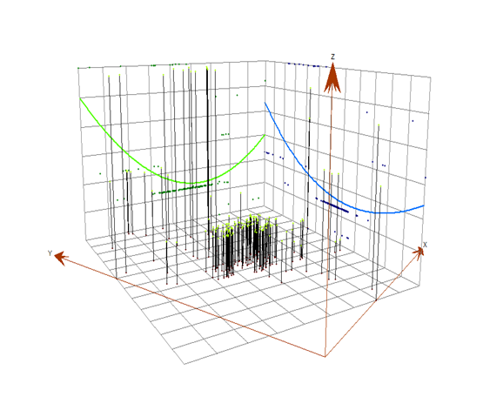
FIGURES 3 – 4B: SPATIAL PATTERNS AND TREND OF HEART DISEASE HOSPITAL DISCHARGES, 2012
Figure 3: Spatial Distribution of Heart Disease Hospital Discharges, 2012
Figure 4A: Trend Analysis of Heart Disease Hospital Discharges, 2012

Slide 11
Figure 4B:Spatial Autocorrelation Analysis Results for Heart Disease, 2012
As shown in Figure 12, the low Moran's I (0.3), reveals the presence of clusters of heart disease rates that are high or low.
The z-score of 12.6 standard deviations falls outside the critical value (-2.58 and +2.58 standard deviations).
Means that at the 0.01 confidence level, there is 99 percent certainty the clustered distribution pattern for heart disease could not be the result of random chance.
Therefore, given the z-score of 12.6, there is less than 1% likelihood that this clustered pattern of heart disease could be the result of random chance.

Slide 12
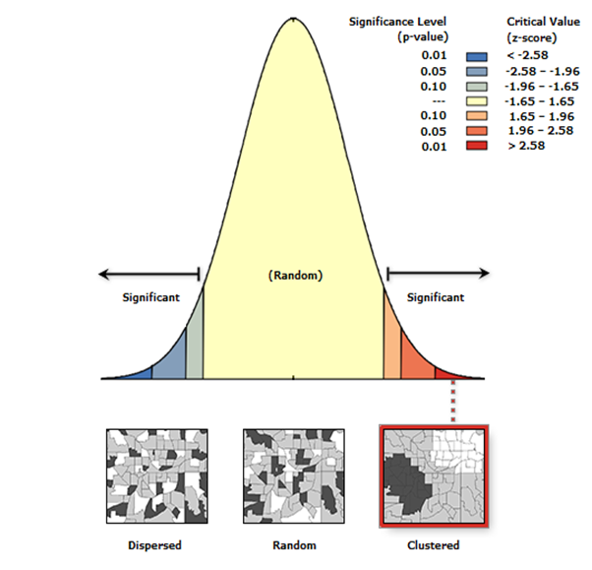
Figure 4B:Spatial Autocorrelation Analysis Statistics for Heart Disease, 2012

Slide 13
FIGURES 5 – 6: Spatial Patterns of HEART DISEASE MORTALITY
Spatial distribution of high heart disease mortality are shown in Figure 5.
Hot and cold spots of heart disease mortality are shown in figure 6.
Spatial patterns of heart disease mortality and hot spots are consistent.
Disparities in spatial patterns of heart disease mortality and heart disease mortality hotspots.
Variations in spatial patterns of heart disease mortality are not due to chance.

Slide 14
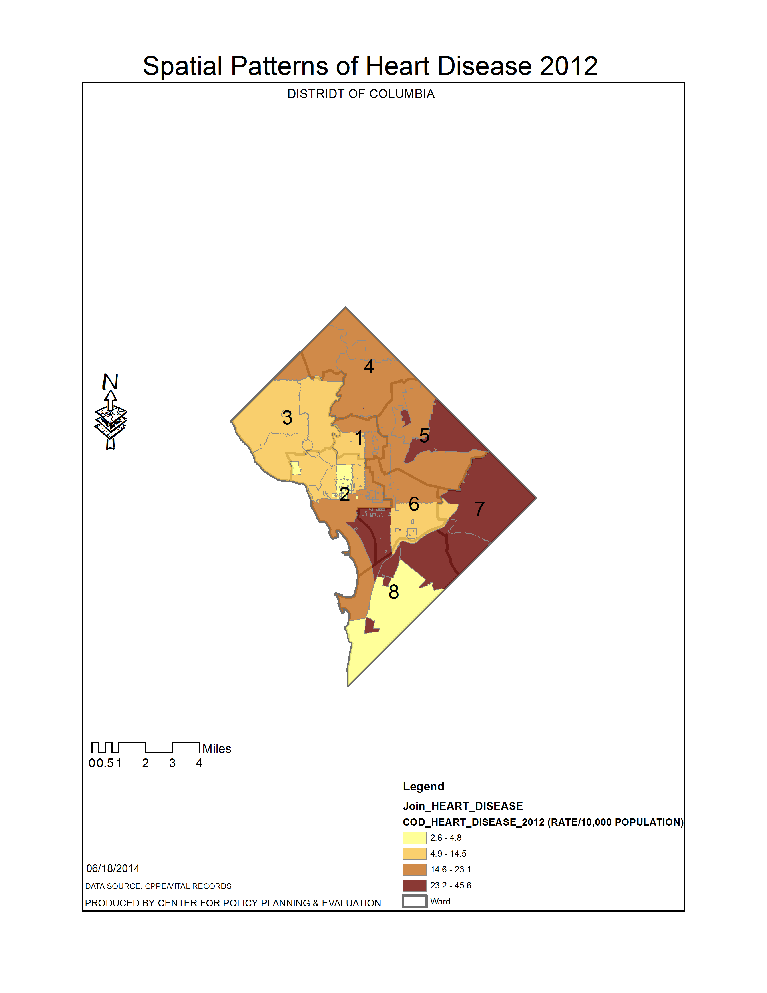
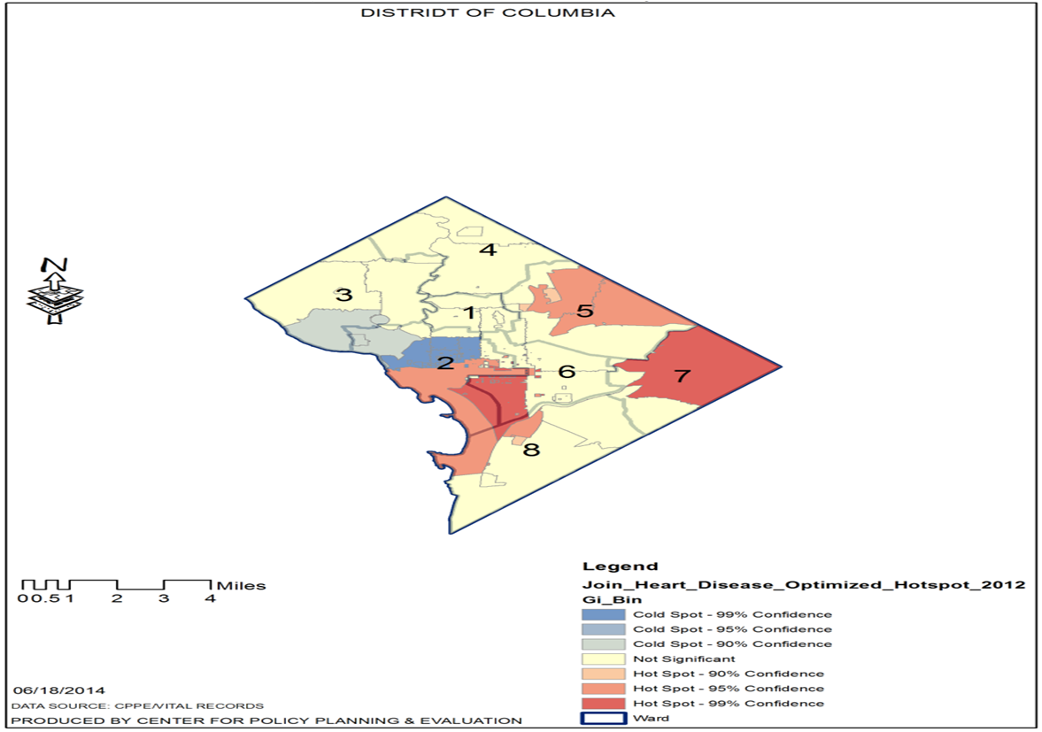
FIGURES 5 – 6: HEART DISEASE MORTALITY, 2012
Figure 5: Spatial Distribution of Heart Disease Mortality, 2012
Figure 6: Hot Spot Analysis of Heart Disease Mortality, 2012

Slide 15
FIGURES 7 – 8: HEART DISEASE INCIDENCE AND HOTSPOTS
Figure 7 shows disparities in the spatial distribution patterns of high heart disease incidence.
Spatial patterns of high heart disease incidence are supported by hotspots analysis in Figure 8.
High heart disease spatial patterns are consistent with hot spots of heart disease incidence .
Variations in spatial patterns of heart disease incidence are not due to chance at 99% and 95% Confidence.

Slide 16
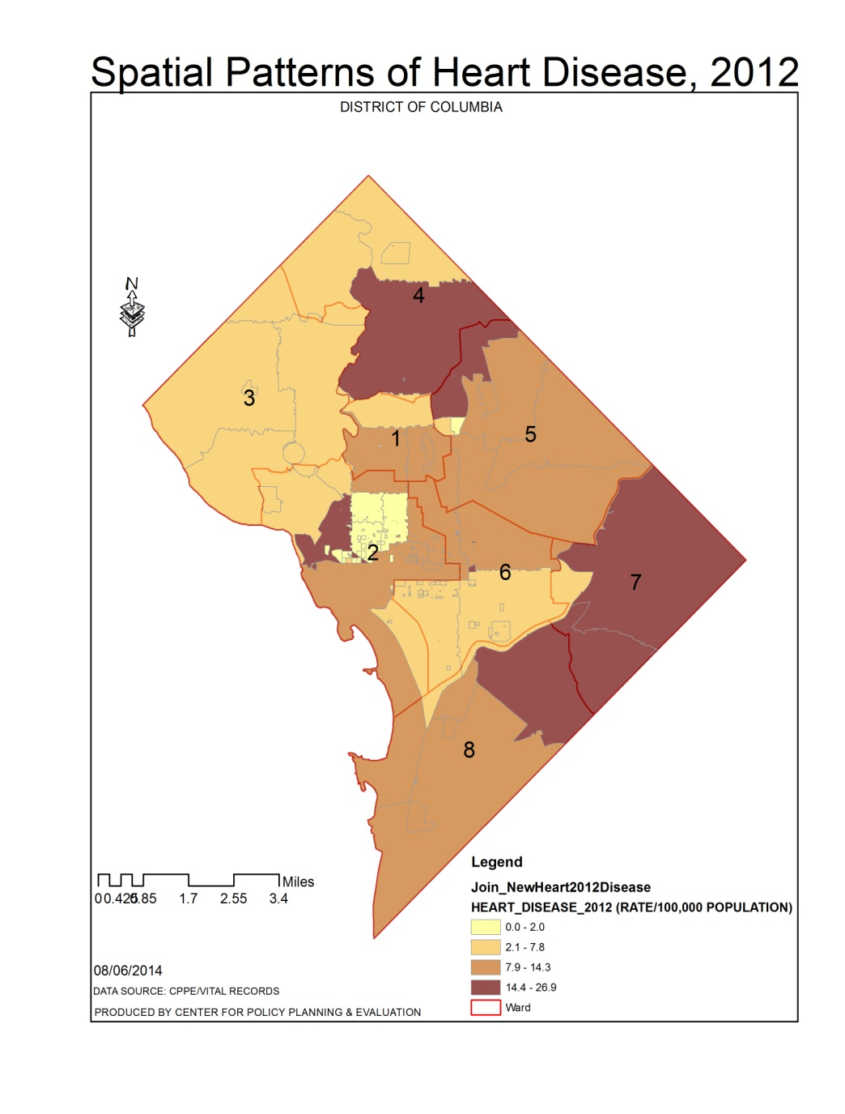
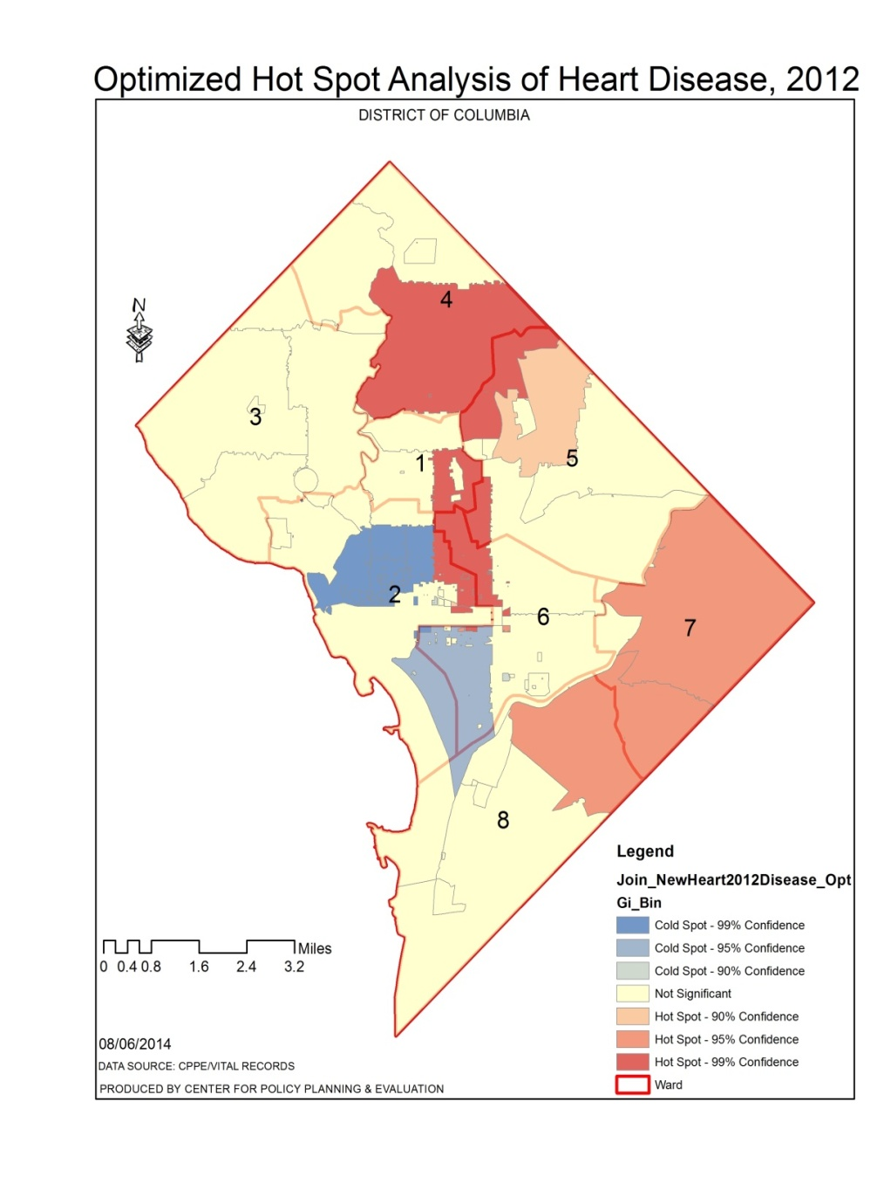
FIGURES 7 – 8: HEART DISEASE INCIDENCE AND HOTSPOTS, 2012
Figure 7: Spatial Distribution of Heart Disease Incidence, 2012
Figure 8: Hot Spot Analysis of Heart Disease Incidence, 2012

Slide 17
Figures 9 - 10:SPATIAL PATTERNS AND TREND OF HEART DISEASE, 2012
Figure 9 shows spatial patterns of heart disease.
Heart Disease starts high in the north (Wards 1, 3, and 5), gradually decrease towards the middle (Ward 6) and increase southward (Blue Arc) in Ward 8 as shown in Figure 10.
Heart Disease also starts high in the east (Ward 7) , gradually decrease in the middle (Wards 2 and 6) and gradually increase westward through Wards 6 and 2 (Green Arc).
Trend analysis can aid in understanding how heart disease progresses within the District’s Wards.
Directional trend analysis can aid in determining where to best locate and spend limited resources to help improve the situation.

Slide 18
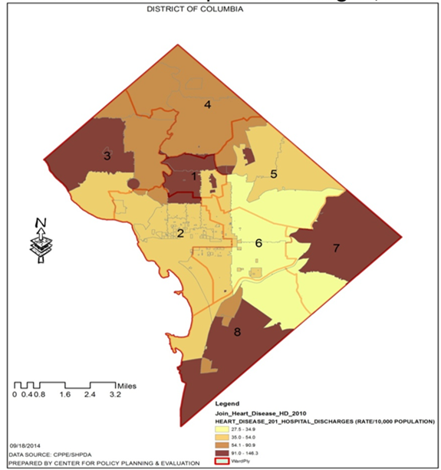

Figures 9 - 10:SPATIAL PATTERNS AND TREND OF HEART DISEASE, 2012
Figure 9: : Spatial Distribution of Heart Disease, 2012
Figure 10: Trend Analysis of Heart Disease, 2012

Slide 19
FIGURES 11A, 11B AND TABLE 1: HEART DISEASE MORTALITY & DOMINANT LIFESTAGE GROUPS, AND EDUCATION
High and low heart disease mortalities are collocated with Young Achievers (Figure 11A).
Sustaining Families are collocated with heart disease mortality rates of 23.2 - 29.6 percent
(Figure 11B).
Heart disease mortality rates of 23.2 - 49.6 percent are collocated with the Affluent Empty
Nesters and Conservative Classics (Figure 11A).
Disparities in heart disease mortality are consistent with associated lifestage groups (Figure
11A and Table 1).
Ward 5 has high heart disease mortality and considered highly educated (Figures 11A - 11B).
Wards 7 and 8 have high heart disease mortality and considered to have some high school
education (Figures 11A - 11B).
High heart disease mortality is collocated with both high and low levels of education.

Slide 20
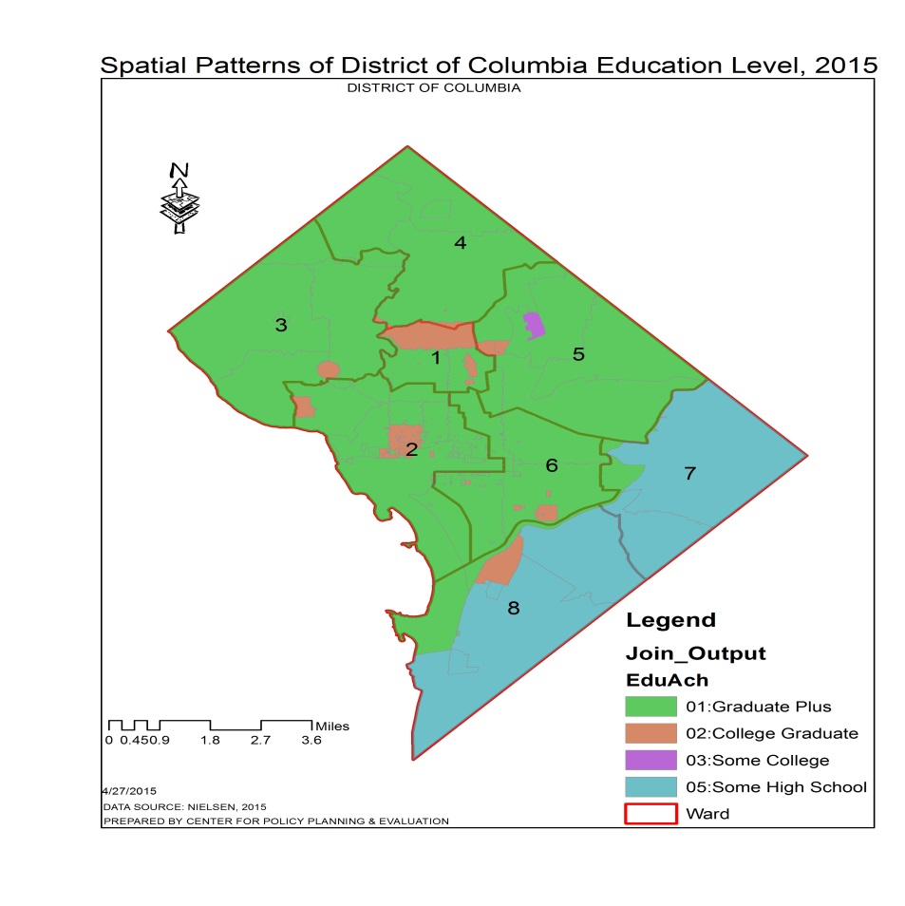
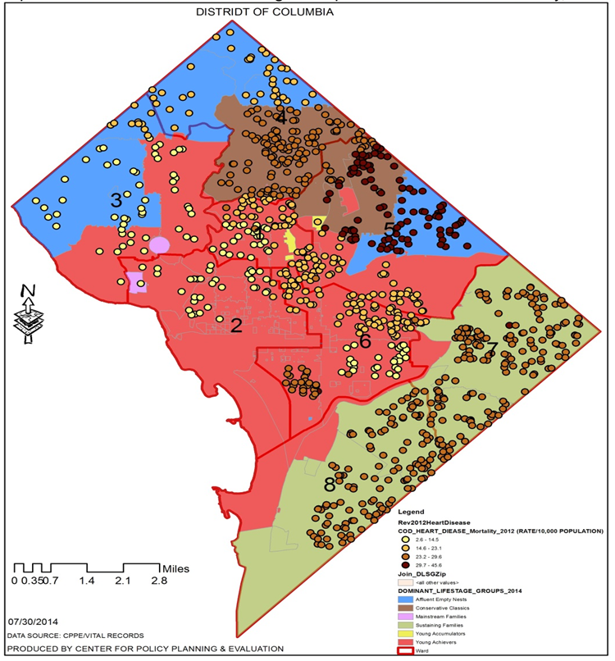
FIGURES 11A, 11B AND TABLE 1: HEART DISEASE MORTALITY & DOMINANT LIFESTAGE GROUPS, AND EDUCATION
Figure 11A: Heart Disease Mortality and Lifestage Groups, 2012 – 2015
Figure 11B: Spatial Patterns of Education, 2015

Slide 21
Table 1: Description of Lifestage Groups, 2015
Lifestage Group | Selected Description | Ethnicity | Ward
Young Achievers | Median HH Income: $91,104, Family Mix - Order from expedia.com - Go water skiing - Read The Economist - Watch Independent Film Channel - Audi A3 | White, Asian, Hispanic, Mix | 1, 2, 3, 4, 5, 6, 7, 8
Sustaining Families | Median HH Income: $25,761, Mostly w/ Kids - In-home cosmetics purchase - Domestic travel by bus - Read Ebony - Watch BET - Nissan Pathfinder | White, Black, Hispanic, Mix | 1, 6, 7, 8,
Affluent Empty Nests | Median HH Income: $121,186, HH w/o Kids - Shop at Saks Fifth Ave. - Belong to a country club - Read Conde Nast Traveler - Watch Golf Channel - Mercedes SL Class | White, Asian, Mix | 1, 2, 3, 4, 5, 6 7
Conservative Classics | Median HH Income: $59,750, Mostly w/o Kids - Shop at Costco - Buy classical music - Read Harper's Bazaar - Watch BBC America - Lexus LX | White, Black, Asian, Hispanic | 2, 3, 4, 5, 7
Young Accumulators (subgroup) | Median HH Income: $74,570, Ethnically diverse and college educated - Live in mid-sized homes in suburban or exurban areas - Favor outdoor sports, campers, powerboats, motorcycles - Media tastes lean towards cable networks targeted to children and teenagers | - | 1, 4, 5, 6, 7

Slide 22
FIGURES 12 – 13: SPATIAL PATTERNS OF DIABETES
High diabetes incidence - collocated with high heart disease incidence in Wards 5, 7, 8, and parts of 4 and 6
zip codes (Figures 12 – 13).
Low diabetes incidence - collocated with low incidence of heart disease in Wards 3 and parts of Wards 1, 2, 4, and 6 zip codes
(Figure 12).
Spatial patterns of high and low incidence of heart disease and diabetes are concurrent in Wards 1, 4, 5, 6, 7 and 8 zip codes
(Figure 12).
Hot spot analysis of Diabetes is consistent with spatial patterns of Heart Disease (Figures 12 - 13).
Hot Spots: variations in spatial patterns of Diabetes and Heart Disease are not due to chance (Figure 13).
Provides level of uncertainty for evidence-based public health decision making.

Slide 23
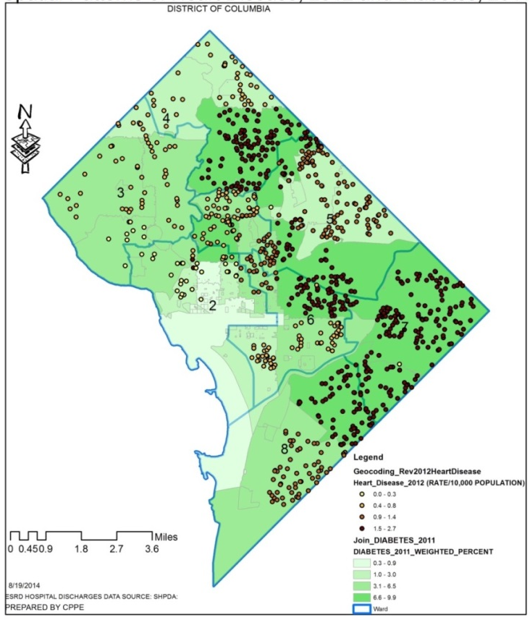
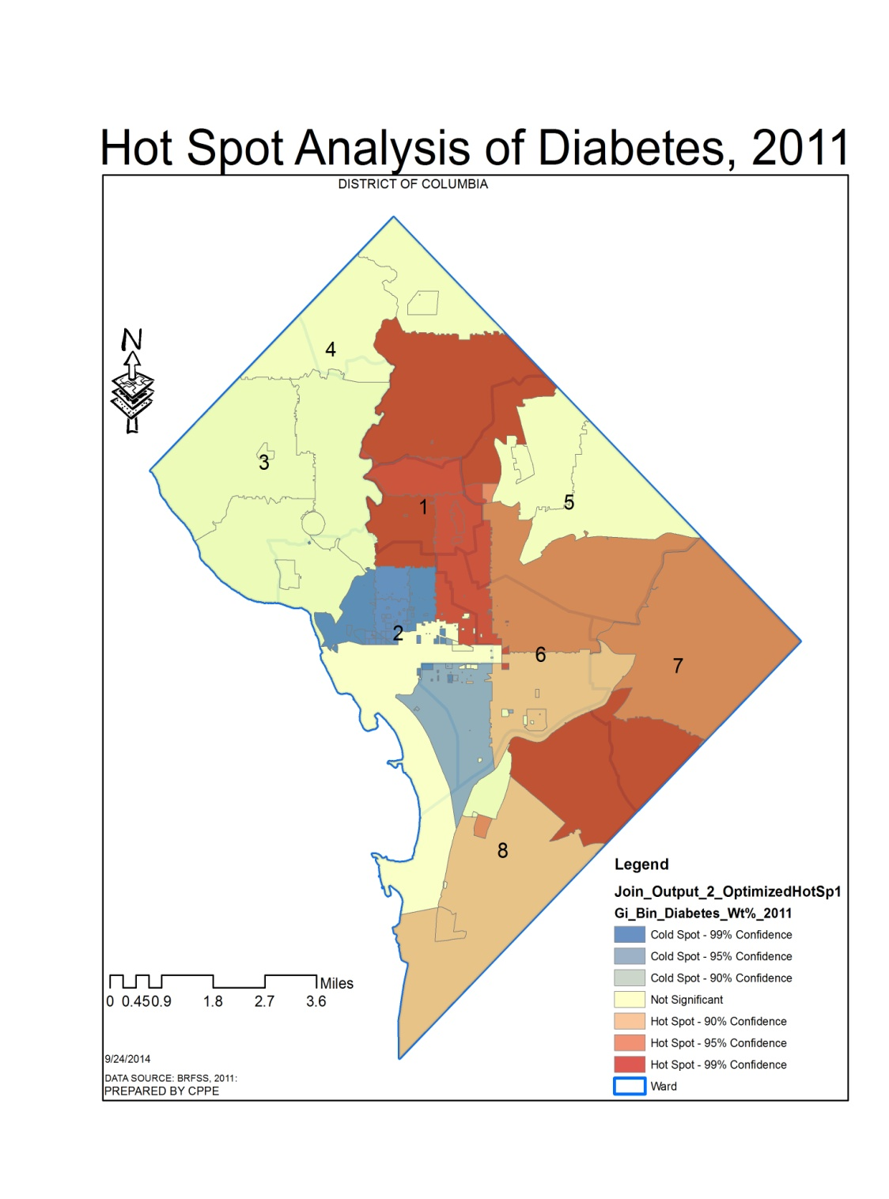
FIGURES 12 – 13: HEART DISEASE , 2012 AND DIABETES, 2011
Figure 12: Spatial Distribution of Diabetes and Heart Disease
Figure 13: Hot Spot Analysis of Diabetes, 2011

Slide 24
FIGURES 14 – 15: OBESITY AND HEART DISEASE
High obesity rates (Red to Brown Polygons) at 0.3 - 0.4 percent (Figure 14).
Collocated with high heart disease incidence (Dark to Light Blue Dots) at 0.9 – 2.7 percent in Wards 4, 5, 7, 8 and parts of 6 zip codes (Figure 14).
Low obesity incidence (Light Brown to Yellow Polygons) at 0.0 to 0.8 percent.
Collocated with low incidence of heart disease (Graduated Green Dots) in Wards 3 and parts of 1, 2, 4 and 6 zip codes.
Spatial patterns of high and low incidence of heart disease and obesity are concurrent.
Disparities in spatial patterns and hotspots of obesity are not due to chance (Figure 15).

Slide 25
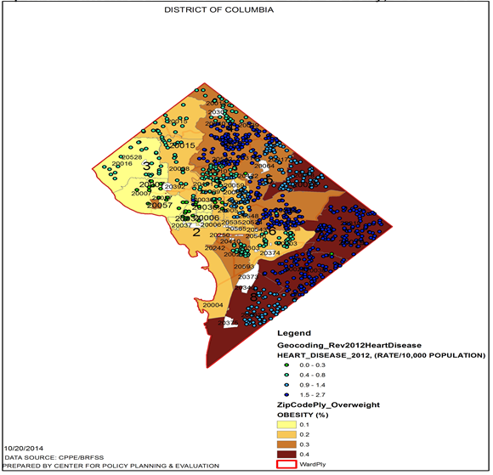
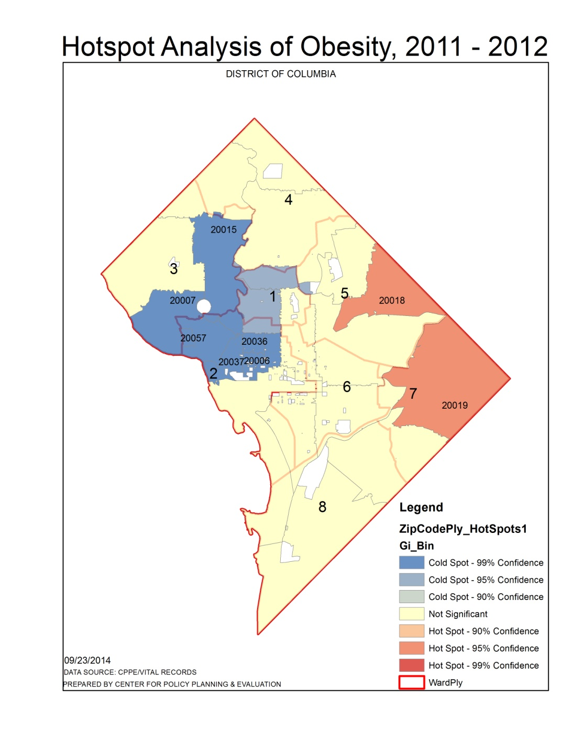
FIGURES 14 – 15: HEART DISEASE, 2012 & OBESITY, 2011-2012
Figure 14: Spatial Distribution of Heart Disease, 2012, and Obesity, 2011-2012
Figure 15: Hot Spot Analysis of Obesity, 2011

Slide 26
FIGURES 16 – 17: OVERWEIGHT & HEART DISEASE
High overweight rates (Brown Polygons) at 0.4 percent.
Collocated with high heart disease incidence (Dark to Light Blue Dots) at 0.9 – 2.7 percent in parts of Wards 4, 5, 6, 7, and 8 zip codes (Figure 16).
Low percentages of overweight (Light Brown to Yellow Polygons) at 0.1 to 0.3 percent (Figure 16).
Collocated with low incidence of heart disease (Graduated Green Dots) in Wards 1, 2, 3, 4, and 6 zip codes (Figure 16).
Hotspots of overweight (Figure 17) and Obesity (Figure 15) are concurrent in Ward 5 and northwest corner of Ward 7.
Statistically insignificant spots (Yellow Polygons) of Overweight are shown in the rest of the Wards while hotspots (Red Polygons) are located in the center and east at 95% Confidence (Figure 17).

Slide 27
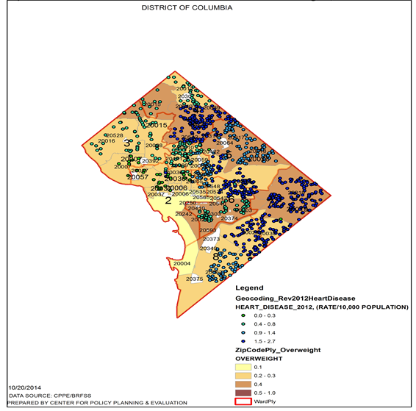
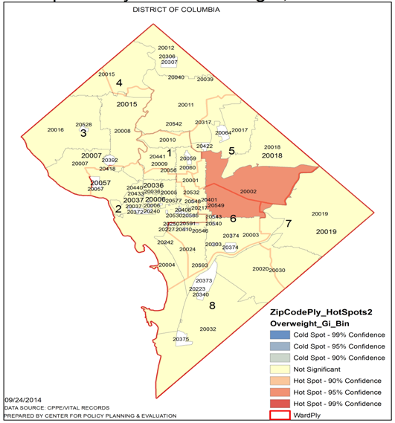
FIGURES 16 – 17: HEART DISEASE, 2012 & OVERWEIGHT, 2011-2012
Figure 16: Spatial Distribution of Heart Disease, 2012 and Overweight, 2011-2012
Figure 17: Hot Spot Analysis of Overweight, 2011-2012

Slide 28
FIGURES 18 - 19: SMOKING, HEART DISEASE AND FOOD DESERTS
Proxy variable for smoking: annual average cigarettes expenditures per household in the District (Figure 18).
Average annual cigarette expenditures (Green Polygons) - highest among households in Ward 8 zip codes, and parts of Wards 1, 2, 3, 5, 6 and 7 zip codes .
Lower average annual cigarette expenditures - shown in parts of all Ward zip codes.
Ward zip codes with higher cigarettes expenditures (Wards 4, 5, 6, 7, and 8) parallel those with high heart disease incidence and mortality.
Hot spots of heart disease are collocated with high cigarette expenditures in Wards 1, 2, 5, 6, 7, and 8.
Food deserts are located in Wards 1, 2, 4, 5, 6, 7, and 8 zip codes but absent in Ward 3 zip codes (Figure 19).
Hotspots of heart disease incidence (Figure 8) - collocated with food deserts in parts of Wards 1, 2, 4, 5, 6, 7, and 8 zip codes (Figure 19).
Spatial patterns of Wards with food deserts are consistent with spatial patterns of high heart disease incidence and mortality.

Slide 29
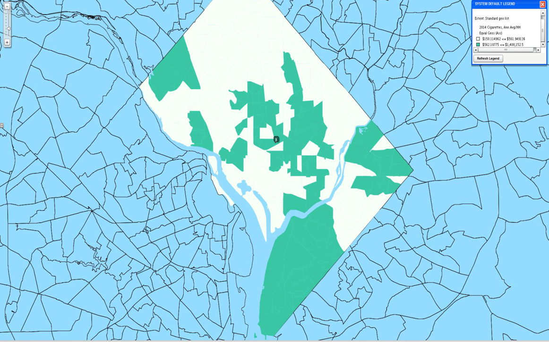
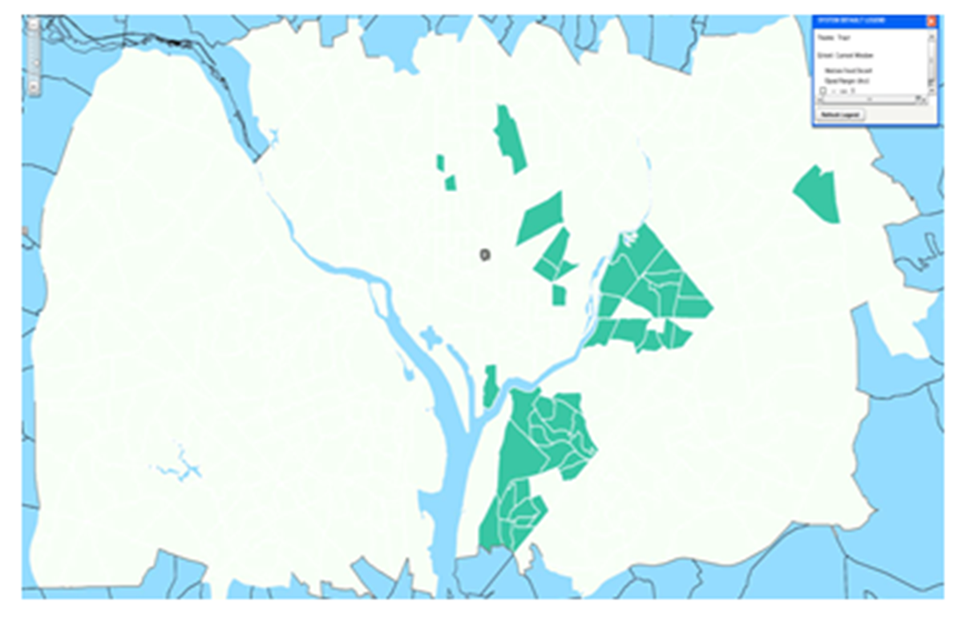
FIGURES 18 - 19: SMOKING, HEART DISEASE AND FOOD DESERTS
Figure 18:Cigarette Expenditures, 2014
Figure 19: Food Deserts, 2014

Slide 30
FIGURES 20: 21:HEART DISEASE AMONG 65PLUS-AGE GROUPS AND INCOME, 2012
Highest heart disease incidence rates, 0.9 - 2.7 percent (brown and light brown dots), are shown in Wards 4, 7, and 8 (Figure 20).
Wards 5 and 6 zip codes (Red Polygons) show the highest percentage of the 65-plus age group (6.0 to 12.6 percent)
High heart disease incidence (Brown Dots) - collocated with advanced age (65-Plus) in parts of Wards 4, 5, 6, 7, and 8 zip codes (Red Polygons).
High heart disease is collocated with upper middle income in Wards 1, 4 and 5 (Figure 21).
High heart disease is also collocated with low income in Wards 7 and 8 (Figure 21).

Slide 31
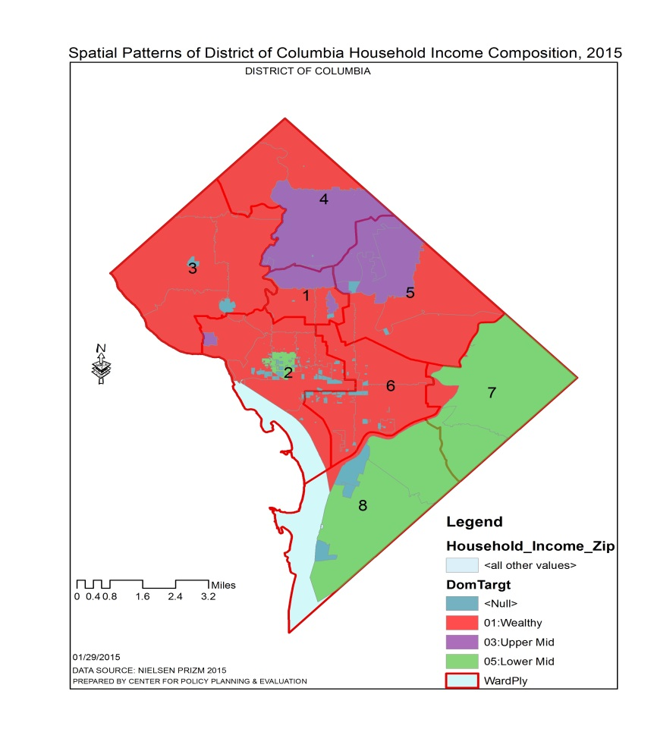
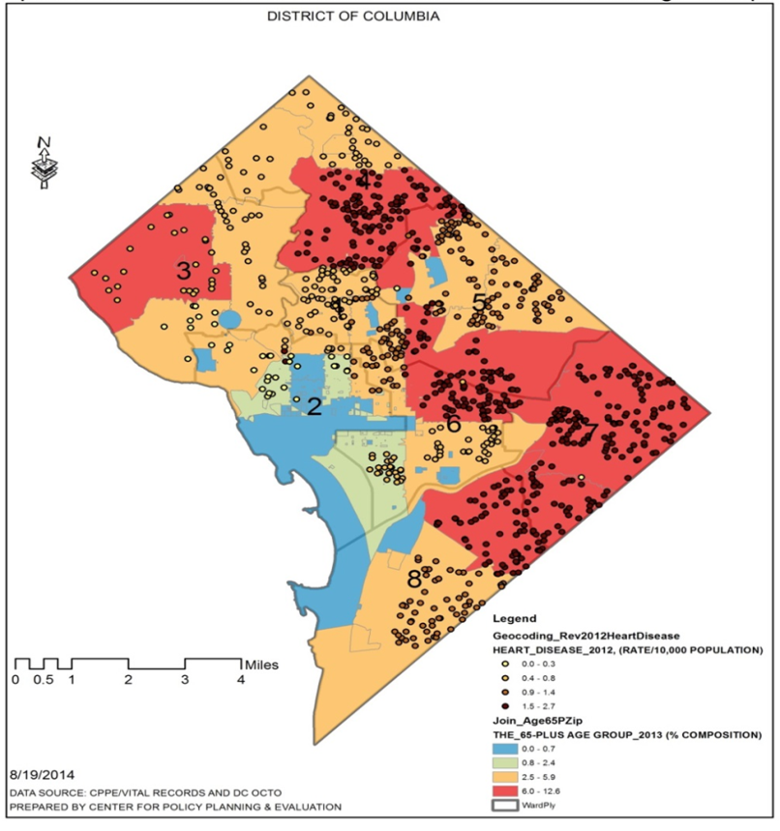
FIGURES 20 - 21:HEART DISEASE AMONG 65PLUS-AGE GROUPS AND INCOME, 2012
Figure 20: Heart Disease Among 65-Plus Age Group
Figure 21: Spatial Patterns of Income

Slide 32
FIGURES 22 - 23: PREDICTING SPATIAL PATTERNS OF HEART DISEASE INCIDENCE BASED ON 2012 DATA (BAYESIAN KRIGING)
Hot spots of heart disease incidence are predicted in Wards 2, 4, 5, 6, 7 and 8 zip codes (Figure 22).
Cold spots are predicted for Wards 2 and 5 zip codes (Figure 22).
Standard error map shows all zip codes of predicted heart disease are between 0.45 – 2.1 (Figure 23 ).
Heart disease rates predicted in white polygons have low errors associated with their predicted values.
Figure 23 quantifies the level of uncertainty associated with the prediction map in Figure 22.
Lighter Polygons: show low errors – concentrated away from the edges (Figure 23).
Darker Polygons: high errors – concentrated at the edges (Figure 23).

Slide 33
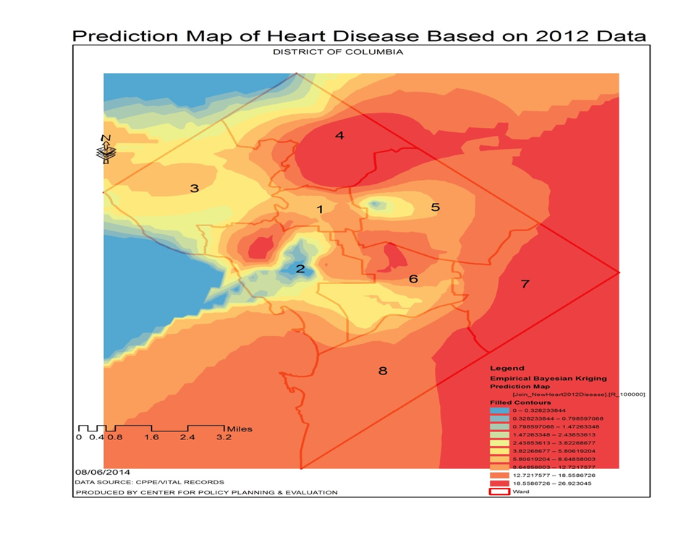
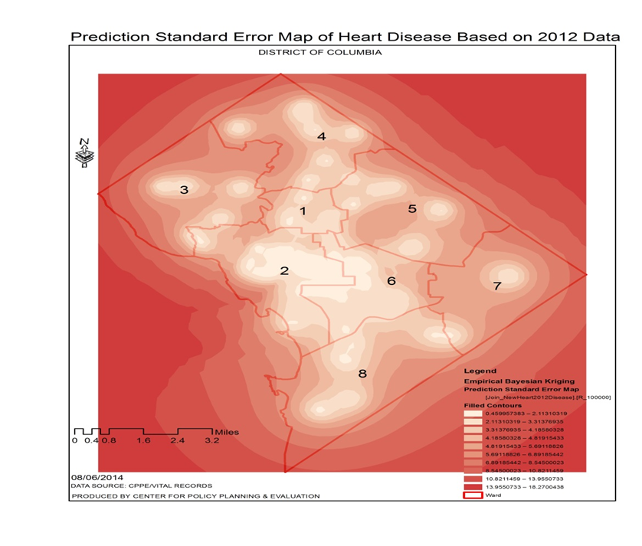
FIGURES 22 - 23: PREDICTING SPATIAL PATTERNS OF HEART DISEASE (BASED ON 2012 DATA)
Figure 22: Predictive Model of Heart Disease, 2012
(Bayesian Kriging)
Figure 23: Standard Error Map of Predictive Model

Slide 34
CONCLUSIONS
Burden of heart disease - disproportionately distributed across the population.
Disparities in heart disease incidence and mortality: consistent with diabetes, obesity, smoking and non-modifiable risk factors (i.e., age, access to healthy foods).
Greatest public health burden of heart disease: in parts of Wards 2, 5, 6, 7, and 8 zip codes.
Generally heart disease mortality: greater among vulnerable populations (65-Plus age group).
Some zip codes in Wards 4, 5, 6, 7, and 8: consistently show high heart disease incidence and mortality rates.
Zip codes in Wards 2, 3 and parts of Ward 1: consistently show the lowest heart disease incidence and mortality rates (Cold Spots).
Lowest heart disease mortality rates: generally collocated with Affluent Empty Nesters and Young Achievers.
High mortality rates: generally collocated with Sustaining Families and Conservative Classics.

Slide 35
CONCLUSIONS
Hot and cold spots of heart disease hospital discharges: collocated in Wards 1, 3, 4, 5, and parts of 8 zip codes.
Cold spots of heart disease burden - most consistent in Ward 2 zip codes.
High cigarette expenditures: collocated with high heart disease mortality rates.
Highest heart disease incidence rates – collocated with the 65+ Age Group.
Zip codes with the high rates of poverty, obesity, diabetes, and heart disease: collocated with food deserts.

Slide 36
LIMITATIONS
Preliminary records for year 2012 incidence, mortality, and hospital discharges were used for this study.
BRFSS 2011-2012 Obesity and Overweight data - used to determine the spatial distribution patterns of obesity among District
Wards.
Current year, 2014 data: provide a more current understanding of the impact of cofactors on public health burden of heart disease
in the District.
Manner in which questions are worded and the ability of individuals to recall details may result in inaccuracies.
That is BRFSS relies on information reported directly by the respondent - self-reported data may be subject to errors.

Slide 37
LESSONS LEARNED
Consistency of high public health burden of heart disease in the northeast-southeast of the District.
Seven zip codes in Ward 2 consistently had low heart disease incidence, mortality and hospital discharge rates.
Spatial trend analysis of heart disease can enhance tailored heart disease burden intervention strategies.
That is, spatial trend analysis: aids decision-making about where to best locate and spend limited intervention resources.
Recognition of disparities in spatial pattern of lifestage groups: aids in designing cost effective and targeted interventions.
Generally food deserts and cigarette expenditures (proxy for smoking): collocated in most District Wards .
Use of multiple spatial methods that point to similar results strengthens confidence in results obtained for evidence-based decision making.
High heart disease mortality rates are collocated with both high income and high education levels.

Slide 38
SELECTED REFERENCES
1.“ABCs” of Heart Disease and Stroke Prevention and Management are defined as A- Aspirin therapy for appropriate populations; B-Blood pressure control; C-Cholesterol control, and S-Sodium reduction and Smoking cessation .
2. Heidenreich PA, Trogdon JG, Khavjou OA, Butler J, Dracup K, Ezekowitz MD,et al. Forecasting the future of cardiovascular disease in the United States: a policy statement from the American Heart Association. Circulation 2011; 123 (8):933-944.
3. Data Management and Analysis Division, Center for Policy, Planning and Evaluation, DC Department of Health.
4. Note: Preliminary 2012 Data Source: Data Management and Analysis Division, Center for Policy Planning and Evaluation, DC Department of Health .
5. Note: Preliminary 2012 Data Source: Data Management and Analysis Division, Center for Policy Planning and Evaluation, DC Department of Health
Anselin, L. (1995). “Local Indicators of Spatial Association—LISA”, Geographical Analysis, 27, 93-115
6 Siaway, G. (2009). ”Evaluation of the Relationship between Indoor Radon and Geology, Topography and Aeroradioactivity.” A dissertation submitted in partial fulfillment of the requirements for the degree of Doctor of Philosophy at George Mason University, Fairfax, VA.”

Slide 39
SELECTED REFERENCES
7. Siaway, G. (2009). ”Evaluation of the Relationship between Indoor Radon and Geology, Topography and Aeroradioactivity.” A dissertation submitted in partial fulfillment of the requirements for the degree of Doctor of Philosophy at George Mason University, Fairfax, VA.”
8. Steinberg, S.L. and S.J. Steinberg. (2015). GIS Research Methods Incorporating Spatial Perspectives, First Edition, ESRI Press, Redlands, CA, pp 1 – 409.
9. Lloyd, C. (2010). Spatial data analysis - An Introduction for GIS Users, Oxford University Press, Oxford, New York, pp. 1 – 206.
10. Kalkhan, M. (2011). Spatial Statistics – GeoSpatial Information Modeling and Thematic Mapping, CRC Press, Boca Raton, FL, pp. 1 – 166.

