Slide 1

Onsite Technical Assistance and Healthy Policies in
Early Care and Education
Jamie Turner, MPH
Healthy Children, Healthy Weights
Columbus Public Health
Columbus, Ohio
Notes:
Good afternoon, and thank you, Abbey.
I would like to acknowledge Cheryl Graffagnino and Alex Smith as co-authors on this abstract.

Slide 2
Presenter Disclosures
Jamie Turner
(1) The following personal financial relationships with commercial interests relevant to this presentation existed during the past 12 months:
No relationships to disclose
Notes:
I have no financial relationships to disclose.

Slide 3
Healthy Children, Healthy Weights
(HCHW) Background
  Developed by Columbus Public Health (CPH) in 2004
  Originally goal-based
  Now a Policy System Environment (PSE) approach
  The Ohio Healthy Program designation was created in 2010
  CFHS and CHC grantees in Ohio implement statewide
Notes:
In 2004, HCHW originated as an obesity prevention strategy to engage parents through their early learning providers.
The program evolved from a goal-setting approach to a PSE approach to prevent early childhood obesity.
With funding from the Ohio Department of Health in 2010, HCHW partnered with the Ohio Child Care Resources and Referral Association to develop the voluntary Ohio Healthy Program Designation, available to ECE providers across the state which fulfill four criteria, going above and beyond what licensing requires.
The program was developed by RDs in such a way that it can be implemented by non-RDs.
From 2011 through 2014 funders of the program include:
The United Way of Central Ohio
Nationwide Children’s Hospital
Child and Family Health Services Block Grant through the Ohio Department of Health
The Institute for Active Living
The Cardinal Health Foundation

Slide 4




Ohio Healthy Program
(OHP) designation criteria
Attend Ohio-Approved Training
Incorporate a Family Engagement Strategy
Demonstrate Healthy Menus and Snacks
Adopt a Written Policy
Notes:
In order to achieve the OHP designation, a child care center must:
Attend Ohio-Approved professional development training developed by Columbus Public Health – which is a series of 2.5 hour sessions most commonly delivered in a group setting where providers can learn from one another.
Incorporate a Family Engagement Strategy
Adopt a written policy
Demonstrate healthy menus and snacks
HCHW provides TA to childcare centers to help them achieve the Ohio Healthy Programs (OHP) designation, a recognition of centers that provide a healthy environment for children.

Slide 5
Recognition of HCHW
  NACCHO Model Practice Award
  RWJF and CDC declared HCHW theory-sound
  Let’s Move! Child Care Partner
  CDC Media Library includes HCHW Family Engagement campaign
  USDA CACFP Provider Resources includes the HCHW Rings of Fun
Notes:
The recognition of HCHW at CPH includes (read slide)
The Rings of Fun are ready-made classroom activities incorporating physical activity and healthy eating into the State of Ohio Early Learning Development Standards.

Slide 6

Licensing and Quality Rating and Improvement System (QRIS)
Statewide CoIIN piloting a prioritized list of health and wellness standards derived from the Caring for Our Children
Goal is to incorporate standards into existing domains of Ohio’s QRIS and/or licensing.
Notes:
Currently, policy recommendations brought to the attention of state level partners by HCHW are being piloted by a statewide Collaborative Improvement and Innovation Network (CoIIN).

Slide 7
The Five Goals of HCHW
Nutrition and Healthy Eating
Physical Activity
Water First for Thirst
Breastfeeding
Reduced Screen Time
Notes:
Now back to the HCHW program and our experience assisting local child care centers in adopting voluntary health and wellness policies.
Read slide.

Slide 8
Four Components of HCHW
Recruitment
Ohio-Approved Professional Development Training
On-Site Technical Assistance (TA)
Family Engagement Program
Notes:
Technical Assistance (TA) was developed as a result of customer satisfaction surveys, program evaluation, and lessons learned. TA provides one-on-one guidance with center directors to implement what they have or will learn through the HCHW trainings.
Feedback from the providers indicated that they needed on-site support in addition to training. In fact, the TA is continually cited as the most helpful aspect of the HCHW program.

Slide 9
Process of HCHW TA 1
Identify center goals
Let’s Move! Child Care Quiz
Environmental Assessment
Collect menus and policy book
Notes:
The process of TA 1 includes:
Identifying the center’s goals so that we can tailor our policy recommendations
Conducting an environmental assessment where we look for policy opportunities where practices are already in place
Collecting two weeks worth of menus and the policy handbook
Assisting the Director in completing the Let’s Move! Child Care Quiz
Prepartion for the second visit includes making tailored policy recommendations, which align with Caring for Our Children National Performance Standards, as well as the American Academy of Pediatrics and NAPSACC.
American Academy of Pediatrics
NAP SACC
Contra Costa Child Care Council CHOICE (Creating Healthy Opportunities in Childcare
Environments) Child and Healthy Nutrition Program.
Ellyn Satter Childcare Feeding Policy
The Wellness Child Care Assessment Tool
Head Start Program Performance Standards and Other regulations
Missouri Department of Health and Senior Services Bureau of Community Food and Nutrition
Assistance
National Alliance for Nutrition and Activity (NANA)
National Association for Sport and Physical Education (NASPE)
New York City Department of Health and Mental Hygiene Board of Health.
Vermont Department of Health Breastfeeding Friendly Employer Project. Loving Support Makes Breastfeeding Work: Sample Childcare Center Breastfeeding Policy.

Slide 10
Process of HCHW TA 2
Present policy recommendations and menu revisions
Discuss feasibility and strategies
Notes:
The process for TA 2 includes presenting policy recommendations and menu revisions, and discussing feasibility and strategies with the Director and Cook.
After TA 2, support is provided in conducting parent meetings, communicating upcoming changes with staff, and making the environmental changes needed to support the policy adoption. .

Slide 11
Process of HCHW TA 3
Approve policies and menu
Encourage OHP completion
Let’s Move! Child Care Quiz
Discuss Family Engagement Kit
Collect lessons learned
Notes:
The Process of TA 3 includes
Approving policies and menues
Assisting the Director in completing the Let’s Move! Child Care Quiz again
Collecting Lessons Learned
Discussing the Family Engagement Kit which is provided to each center at the completion of policy adoption as a way to engage families in the changes that have been made
and
Encouraging the Director to apply for OHP

Slide 12
HCHW TA Assessments
Assess:
Pre and Post Policy and Menu Counts
Complete:
Wellness Child Care Assessment Tool (WellCCAT)
Survey:
Customer Satisfaction Survey
Notes:
Throughout and at the end of the process se:
Assess pre and post policy and menu counts
Complete the Wellness Child Care Assessment Tool
Survey Directors through a Customer Satisfaction Survey to aid in program improvements

Slide 13


HCHW Family Engagement Program
Evidence-based key message kits
  Activity resources
  Script for providers
  Pre- and post- test for families
Connection to social media campaigns such as Good4Growth
Pilot with local foodbank produce distribution
Notes:
Once a center has adopted policies we engage them in the Family Engagement Program which trains and equips providers to bring learning opportunities to parents on how to make the healthy chocie the easy choice at home.
The Family Engagement Program is currently being piloted with local foodbank produce distribution whereby produce pick-up is coupled with learning opportunities for families.

Slide 14
Technical Assistance intervention
Between January 2011 and December 2014,
HCHW provided 302 TA visits to 97 centers.
  Average of 3 visits per center
Notes:
Between January 2011 and December 2014, HCHW provided 302 TA visits to 97 centers.
Average of 3 visits per center

Slide 15
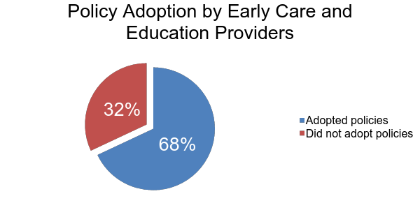
HCHW Results – Policy Adoption
Notes:
As a result, policies were adopted and implemented by 66 (68%) of the 97 centers.

Slide 16
Number of policies adopted by HCHW Providers
Average = 17.3
Minimum = 4
Maximum = 36
Notes:
Only one policy is required to apply for the OHP statewide designation.

Slide 17

Most frequently adopted physical activity policy
  “Center staff will not use physical activity or withhold opportunities for physical activity as punishment.”
Notes:
I will now share with you the most frequently adopted policies by the five goal areas, alongside a corresponding family engagement program key-message which is used to support policy adoption.

Slide 18
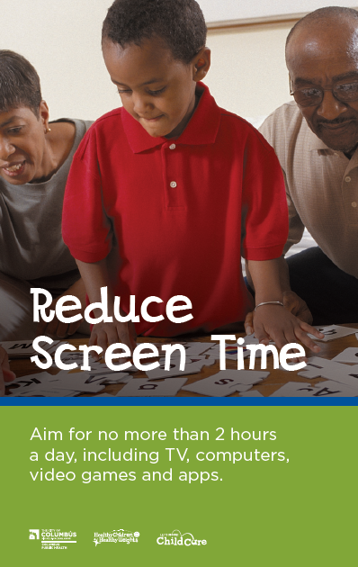
Most frequently adopted screen time policy
  “Television or videos are never shown in the facility.”
Notes:
Read slide.

Slide 19
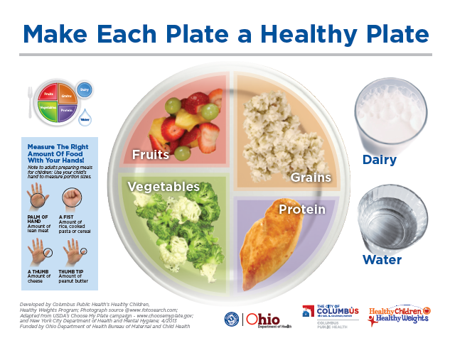
Most frequently adopted nutrition policy
  We:
  Include a different non-fried vegetable every day.
  Include a different whole fruit every day.
  Include at least one whole grain food every day.
  Avoid or limit fried foods to no more than twice a week.
  Serve only 100% juice and no more than 4-6 oz a day.
  Do not serve sweetened beverages.*
* Added as a menu requirement October 1, 2015
Notes:
The most frequently adopted nutrition policy is the OHP menu standards developed by HCHW at CPH. This applies to centers serving one meal and two snacks per day. Adapted standards are available for centers serving less or more meals and snacks.

Slide 20
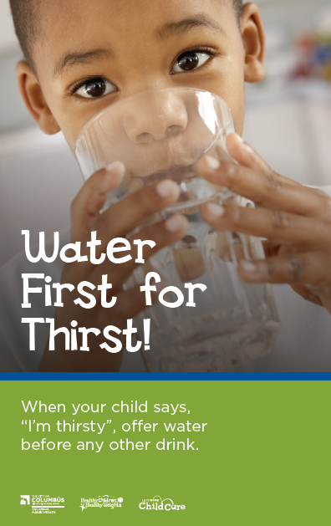
Most frequently adopted water policy
“We make drinking water freely available so children can serve themselves at meals and throughout the day, both inside and outdoors.”
Notes:
Read slide.

Slide 21
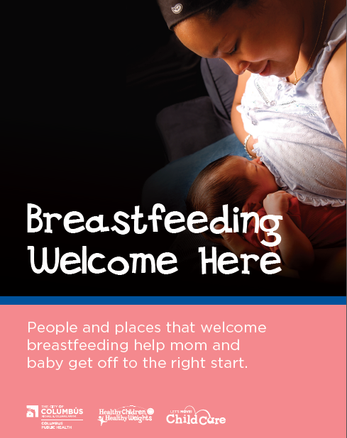
Most frequently adopted breastfeeding policy
“All child care center staff will be trained in the proper storage and handling of human milk, as well as ways to support breastfeeding mothers.”
Notes:
Read slide.

Slide 22
HCHW Intervention Conclusion
Onsite technical assistance is an effective method for adoption of policies in the five HCHW goal areas:
Nutrition and Healthy Eating
Physical Activity
Water First for Thirst
Breastfeeding
Reduced Screen Time
Notes:
Onsite technical assistance is an effective method for adoption of policies by ECE providers in the five HCHW goal areas.

Slide 23
  Thank You!
  Funded by the Cardinal Health Foundation
Jamie Turner, MPH
Healthy Children, Healthy Weights
Columbus Public Health
(614) 645-7520
jbturner@columbus.gov
Notes:
The HCHW program is grant-funded so I’d like to thank the Cardinal Health Foundation and the Child and Family Health Services Block Grant for making this work possible.

