Slide 1
HOW TO SUBMIT A SESSION PROPOSAL
APHA’s 2026 Annual Meeting & Expo
Nov. 1-4• San Antonio, TX

Slide 2
LET’S GET STARTED
When you begin the submission process you will receive an email with your session ID and password. Keep this log-in information handy. You will have 24/7 access to your session and can log in/out up until the submission deadline.

Slide 3
General Information
Session Proposals are 90 minutes and typically include 4–5 speakers who address different aspects of a shared topic. All proposed abstracts are blind reviewed, and each abstract must meet the required scoring threshold for the session to be approved. If a full session is not approved, only those abstracts that meet the scoring threshold will be eligible for inclusion in other sessions covering similar topics.
The session proposal submitter must:
  Enter the overarching session title, session description, and learning outcomes.
  Add themselves as the session proposal submitter.
  Add a session moderator. This can be done during submission or after the proposal has been approved.
  Add proposed speakers and presentation titles.
    Each speaker must have a unique presentation title that is specific to their individual talk and cannot be a duplication of the overarching session title.
    Placeholder titles are acceptable and can be updated by the speaker during the submission of their abstract.
    All speakers will receive an email containing a unique link to continue with the submission of their abstract.

Slide 4
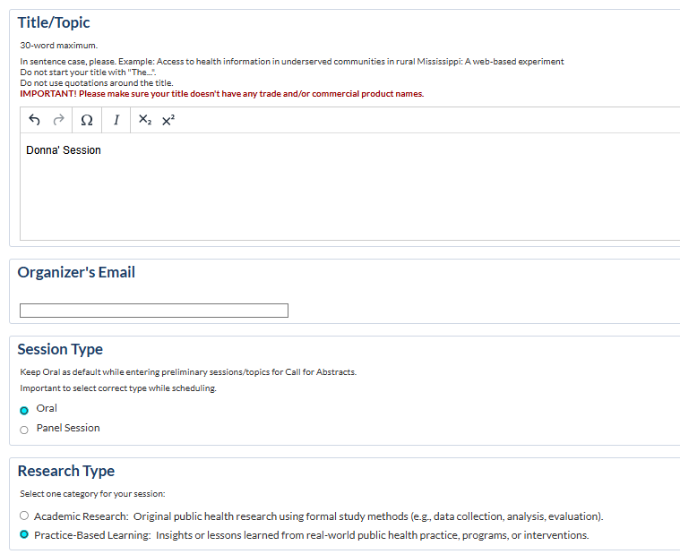
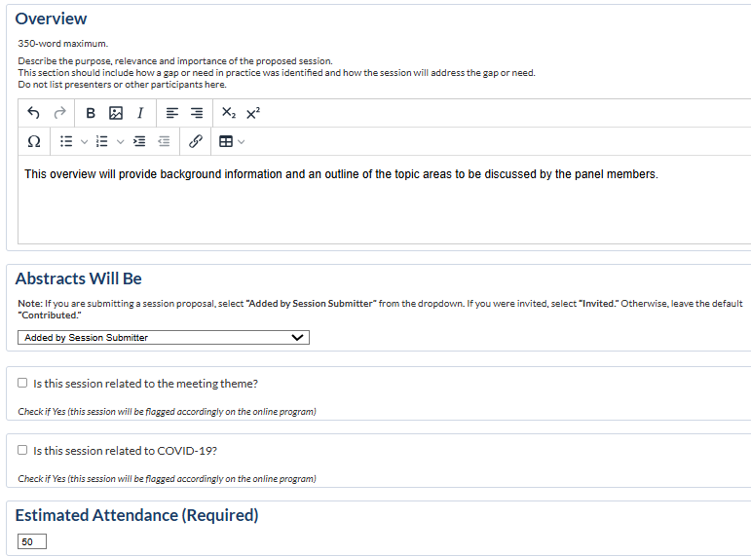

Step 1: Title Step
Enter session title and complete all required fields.
In the dropdown under “Abstracts Will Be”, Select “Added by Session Submitter”
Click “Save” to continue.

Slide 5
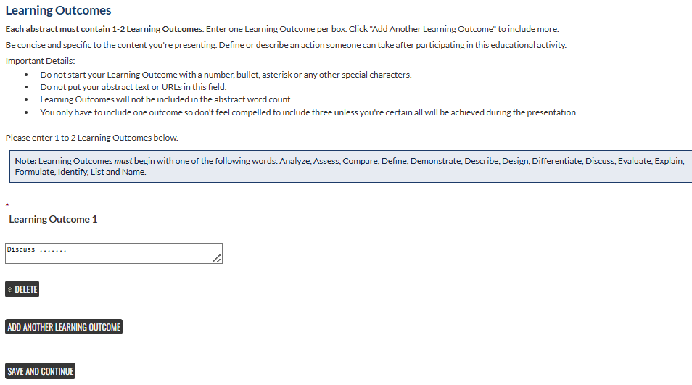

Step 2: Learning Outcomes
Enter 1–2 clear learning outcomes for the session.
Learning outcomes should describe what participants will gain or be able to do.
Click “Save and Continue”.

Slide 6

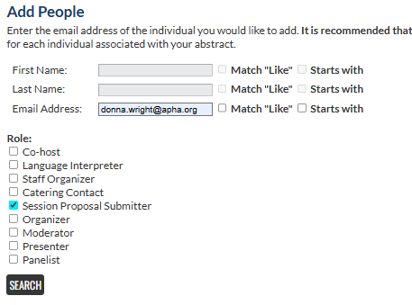
Step 3: Submitter Information
Click “Participants” at the top of the page.
Enter your first and last name or email.
Select the role “Session Proposal Submitter”.
Click “Search”.

Slide 7
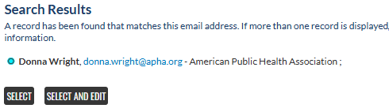
Step 3: Submitter Information (Cont’d)
If your name appears in the search results, click “Select” or “Select and Edit” if updates are needed.
If your name does not appear, select “Not Found – Enter a New Name” and “Select”
Enter name and contact information.
Click “Save and Continue” to proceed.

Slide 8
Step 4: Adding Authors/Speakers/Moderator
Click “Participants” at the top of page, then “Add New Person”.
Enter the speaker’s email address.
Select “Presenter” as the role.
Enter the individual presentation title or a placeholder title.
Click “Search”.
If the speaker’s name appears,
  select the name and hit “Select” or “Select and Edit” if updates are needed.
If the speaker’s name does not appear,
  select “Not Found” and enter the speakers’ name and contact information.
Click “Save and Continue” to proceed.
Now that the first presentation has been added, click “Add New Person” and repeat the above steps until all speakers have been added.
If adding a moderator, select “Moderator” as the role.

Slide 9
Questions
General Annual Meeting Information
Program Committee Contacts
Technical Support

Slide 10
ABOUT APHA
The American Public Health Association champions the health of all
people and all communities. We strengthen the profession of public
health, promote best practices and share the latest public health
research and information. We are the only organization that influences
federal policy, has a 140-plus year perspective and brings together
members from all fields of public health. Learn more at www.apha.org.

